Slide 1
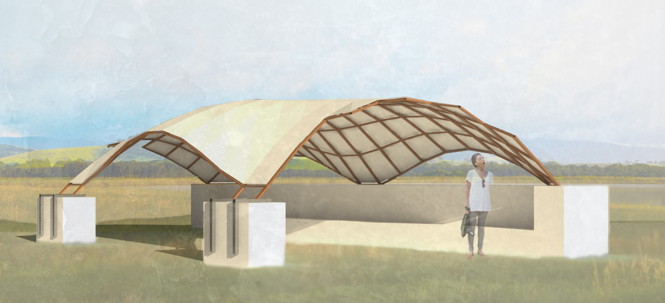
The 5-Point Canopy, a timber gridshell
Final Presentation

Slide 2
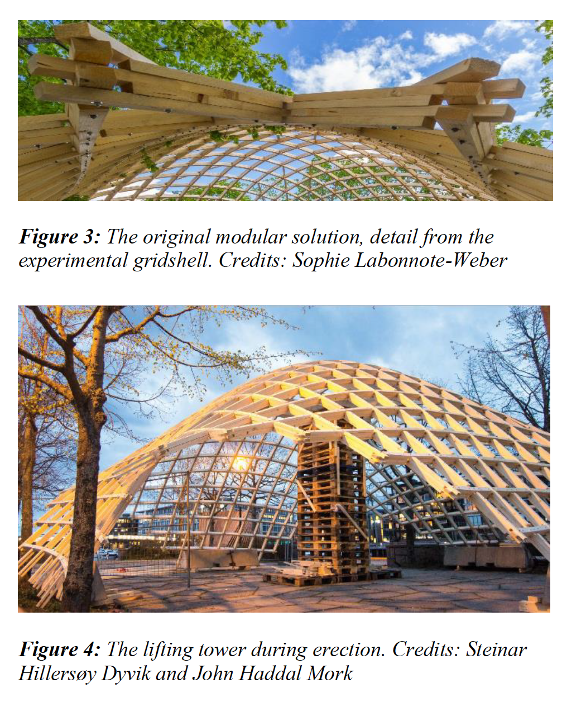
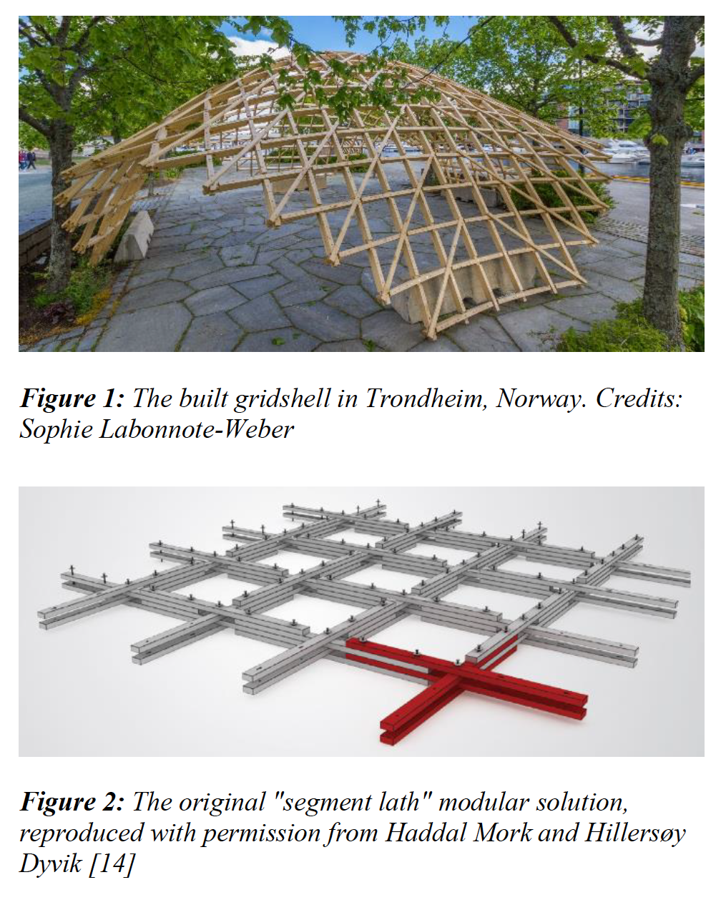
Precedent Studies
Date: March 20 2017 Topic: Precedents
The Trondheim Pavilion
The Trondheim pavilion is a gridshell structure erected in May 2015 at the Krigsseilerplassen in Trondheim, Norway. The construction is a result of a master thesis at the Norwegian University of Science and Technology (NTNU), by John Haddal Mork and Steinar Hillersøy Dyvik.
Lessons learned:
The module – allows for the approximation of long members using reasonably sized pieces. Advantageous for us as the material we had were short segments of solid wood.
Form – gives a general idea of a feasible bending radius and overall shape
Connection to base and bracing – The gridshell’s support connection shows substantial width at the connection to the base and bracing that helps to stiffen the form and reduce displacement and thrust.
Grid vs diagrid – the regular grid allows for simpler connections to the ground
WEEK # 10

Slide 3
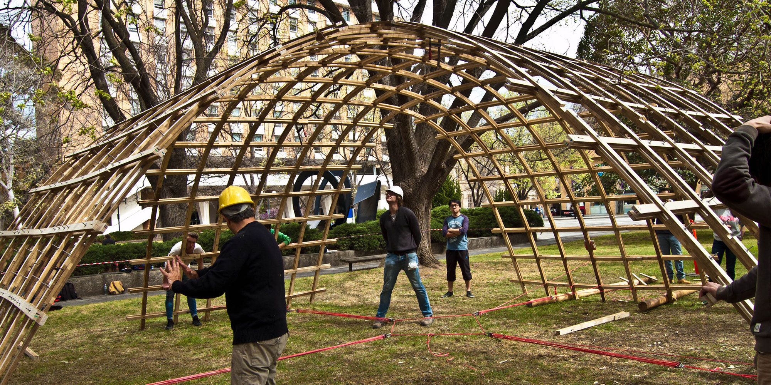
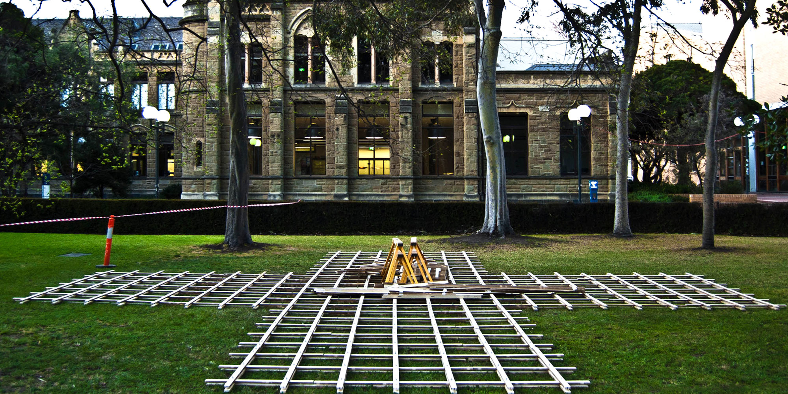
Precedent Studies
Date: March 18 2017 Topic: Precedents
The ACCOYA Pavilion
Completed by the Melbourne School of Design and Gridshell.it, during a student workshop in Melbourne, Australia in Autumn 2014
Lessons learned:
Construction Process–The Tackle – and ancient Greek machine is used to pull the gridshell into shape
Connection to base and bracing:
The base is connection in this precedent
WEEK # 10

Slide 4
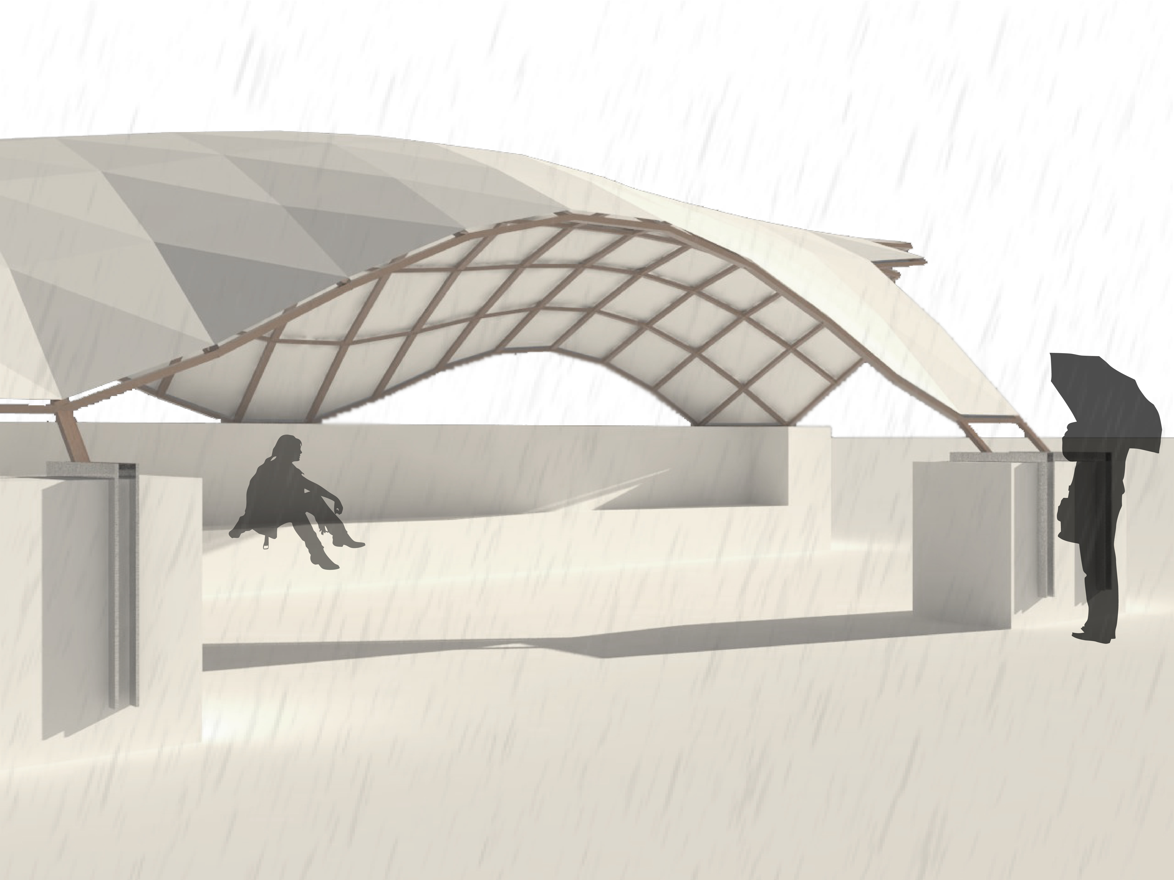
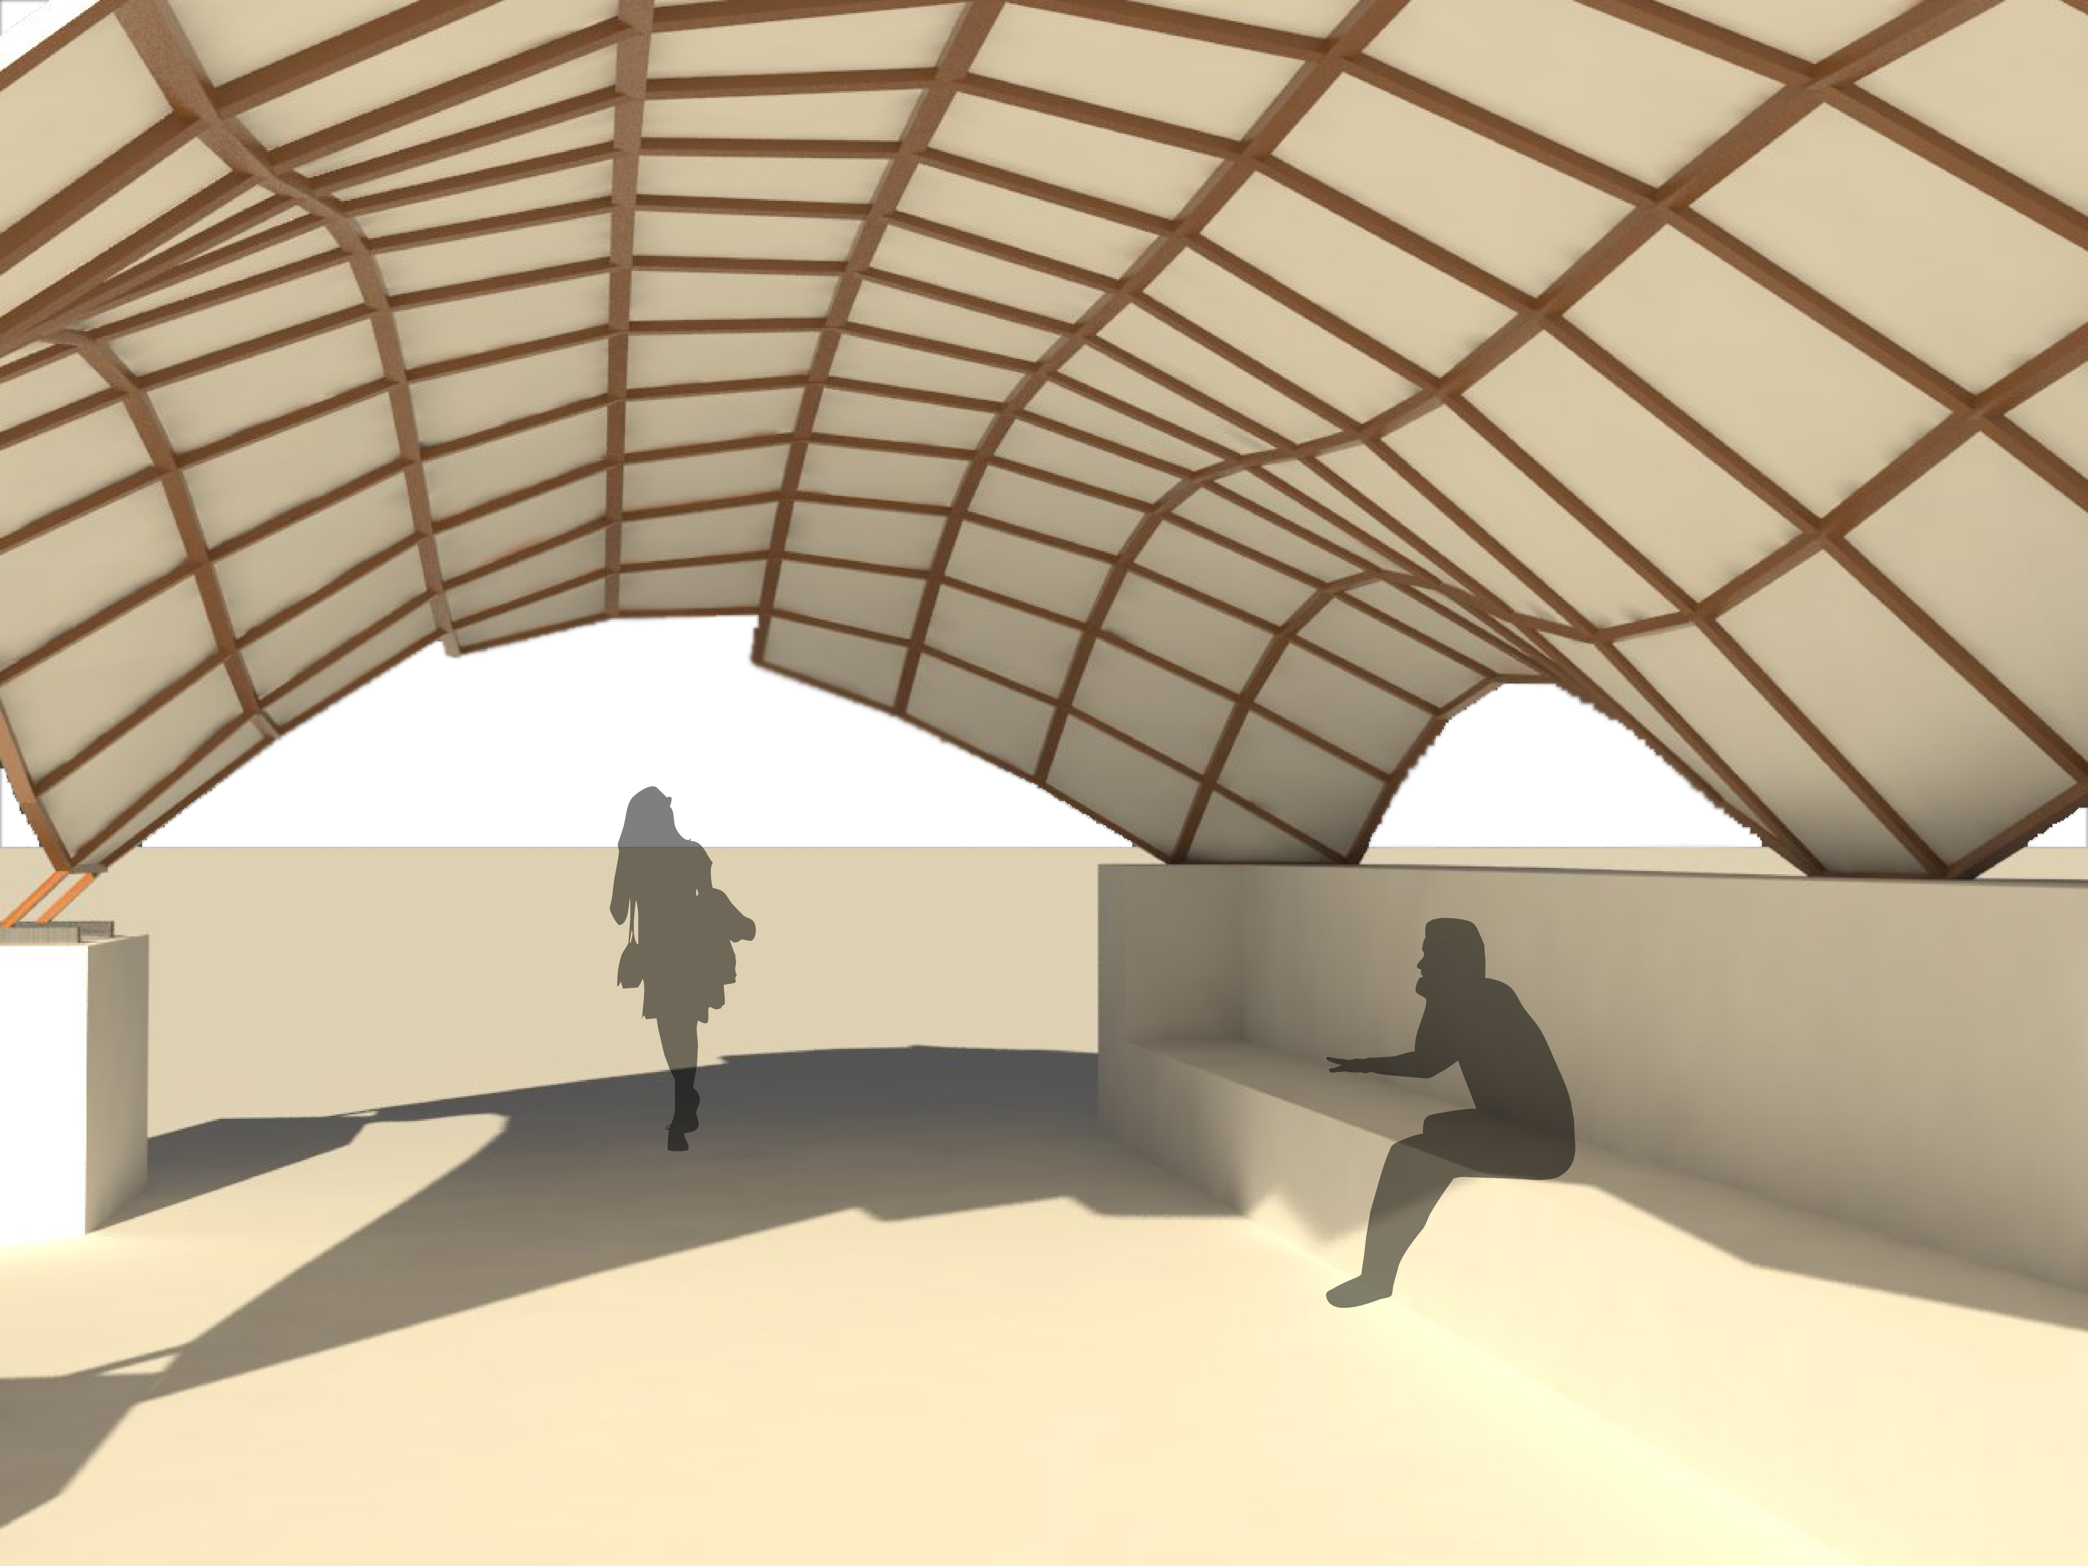
The Design
Date: 3/20/17 Topic: Final Project
The 5-Point canopy as stated in the name touches the ground at 5 points. These points, which rest on a concrete base wall, form the base of a swooping diagrid gridshell. A rain protection canopy protects the wood and the interior from the rain and produces interesting spatial effects. This canopy has the potential to be translucent, which can produce an interesting lighting effect on the interior.
>>Josh Rosenthal

Slide 5
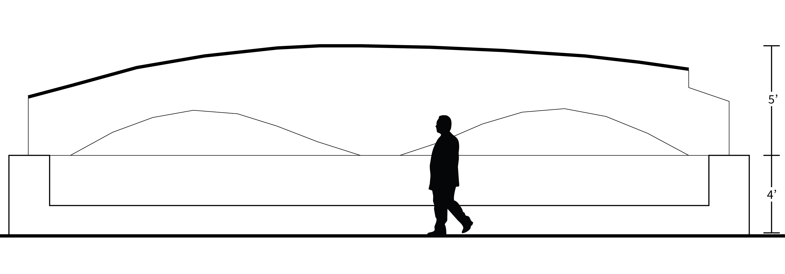
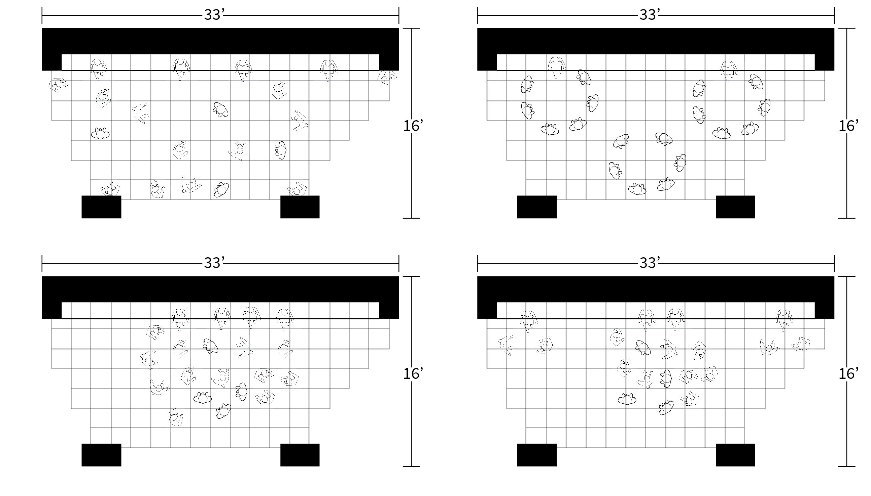
Accommodation
Date: 3/20/17 Topic: Final Project
The canopy is 33’x16’. Through the use of a base retaining wall, the canopy reaches a maximum height of 9’, a comfortable height to walk through. Pictured at right are the various ways in which the canopy can accommodate 20 people. The main support wall contains a bench and the two piers allow for flexible entry.
>>Josh Rosenthal

Slide 6
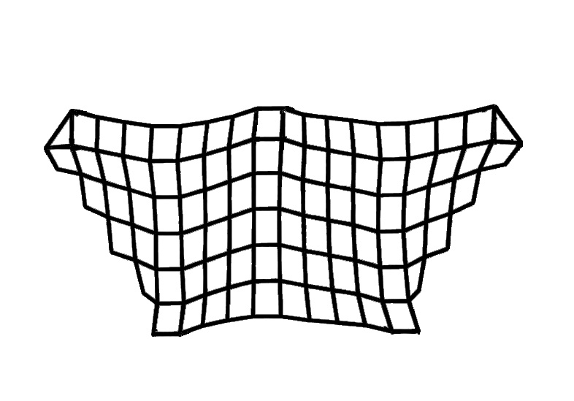
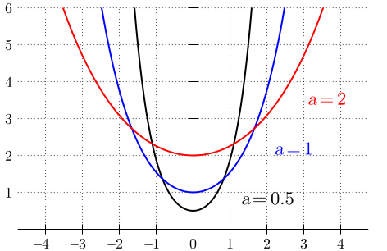
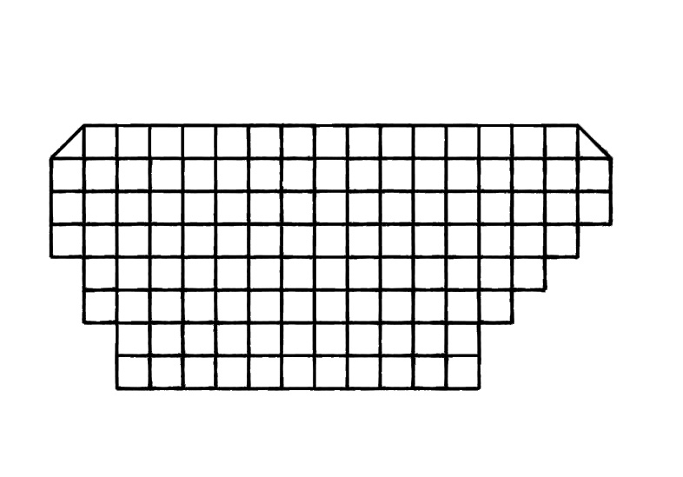
Structural Efficiency of Hanging Chain Models
Date: 20 March 2017 Topic: Canopy Final
Kangaroo
The building shape is using hanging chain model method, formed by gravity load pushed up the grid and five supporting points are pulling back to the ground. Because the shape is formed by the gravity, the shape itself have a resistance to the load.
Karamba and Kangaroo bboth can simulate the hanging chain model, but Karamba is remaining the straight line on the plan view. That’s the reason why we decide to find the form with Karamba instead of Kangaroo.
Hanging Chain Diagram
Karamba

Slide 7
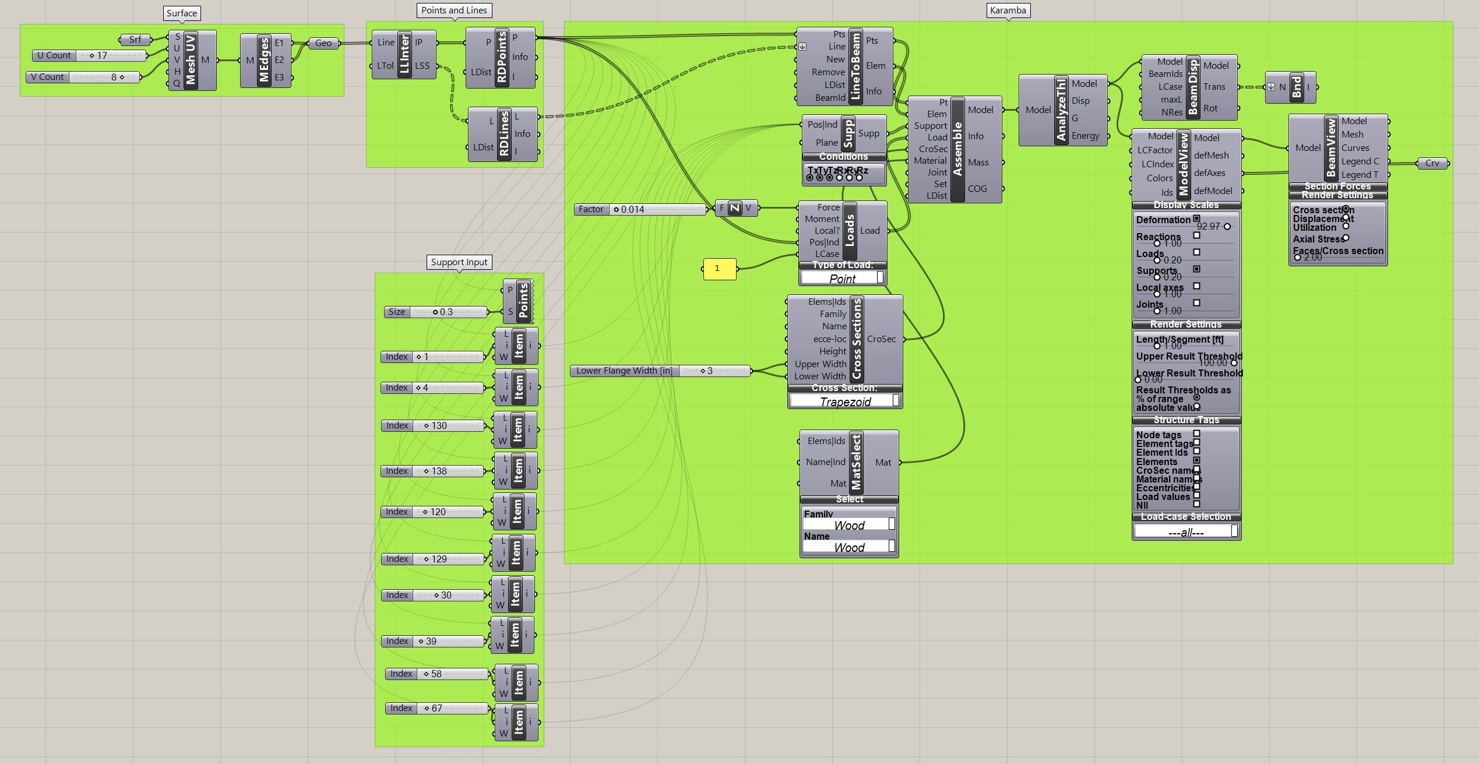
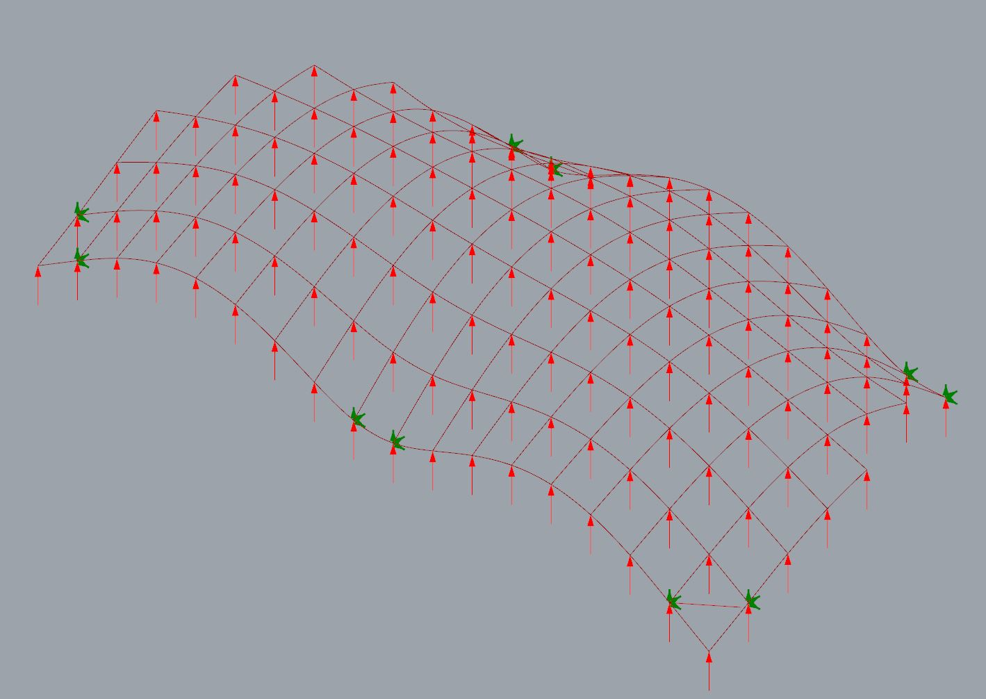
Form Finding
Date: 3/20/17 Topic: Final Project
The definition pictured at right was used for form finding. It consists of a grid on which two supports were added at each of the five points. The grid was then deformed using Karamba to achieve the characteristics of a hanging chain model. Three points were placed on one side while two were placed on the other.
>>Josh Rosenthal

Slide 8
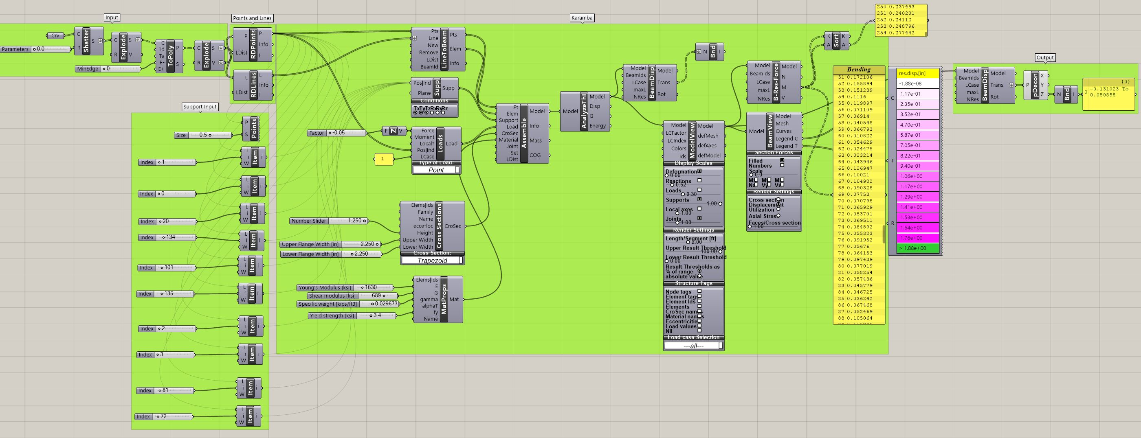
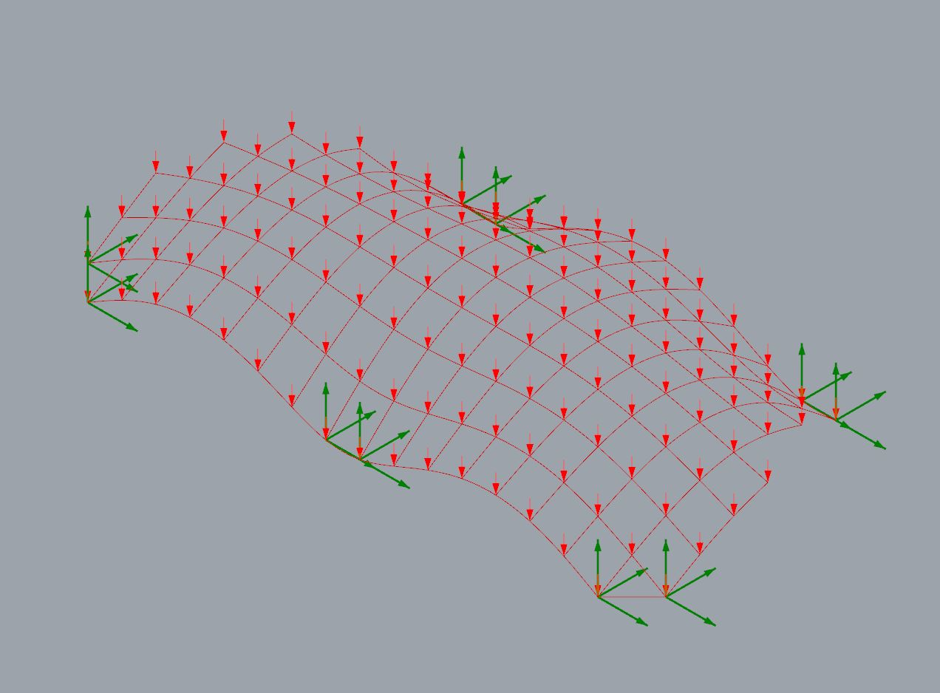
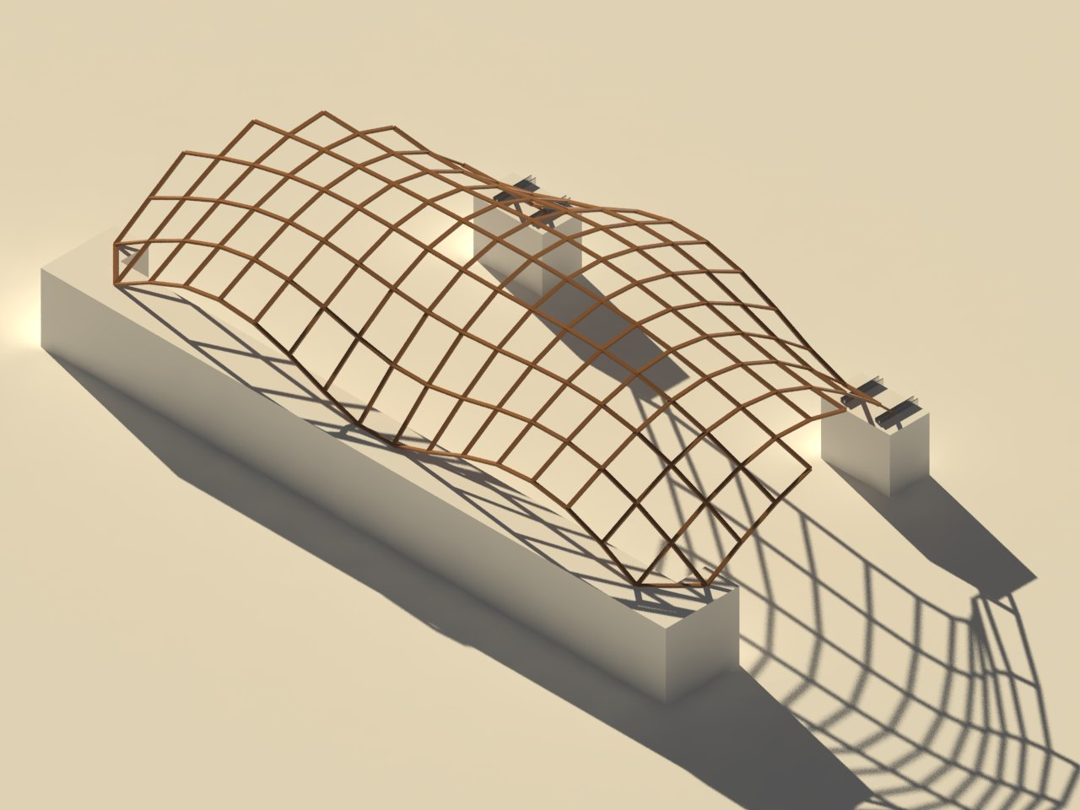
Form
Date: 3/20/17 Topic: Final Project
The definition at right is for re-analyzing the form-found output. Downward forces are applied at each intersection for the purpose of realistic analysis. The image at the bottom right is a rendered structural output.
>>Josh Rosenthal

Slide 9
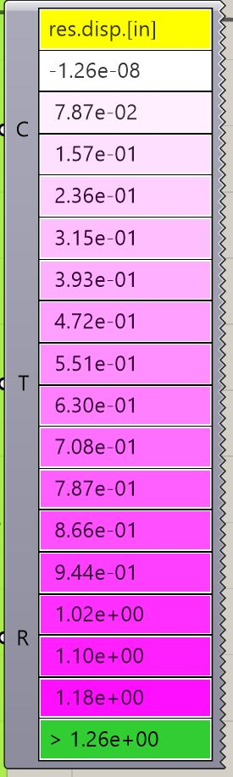
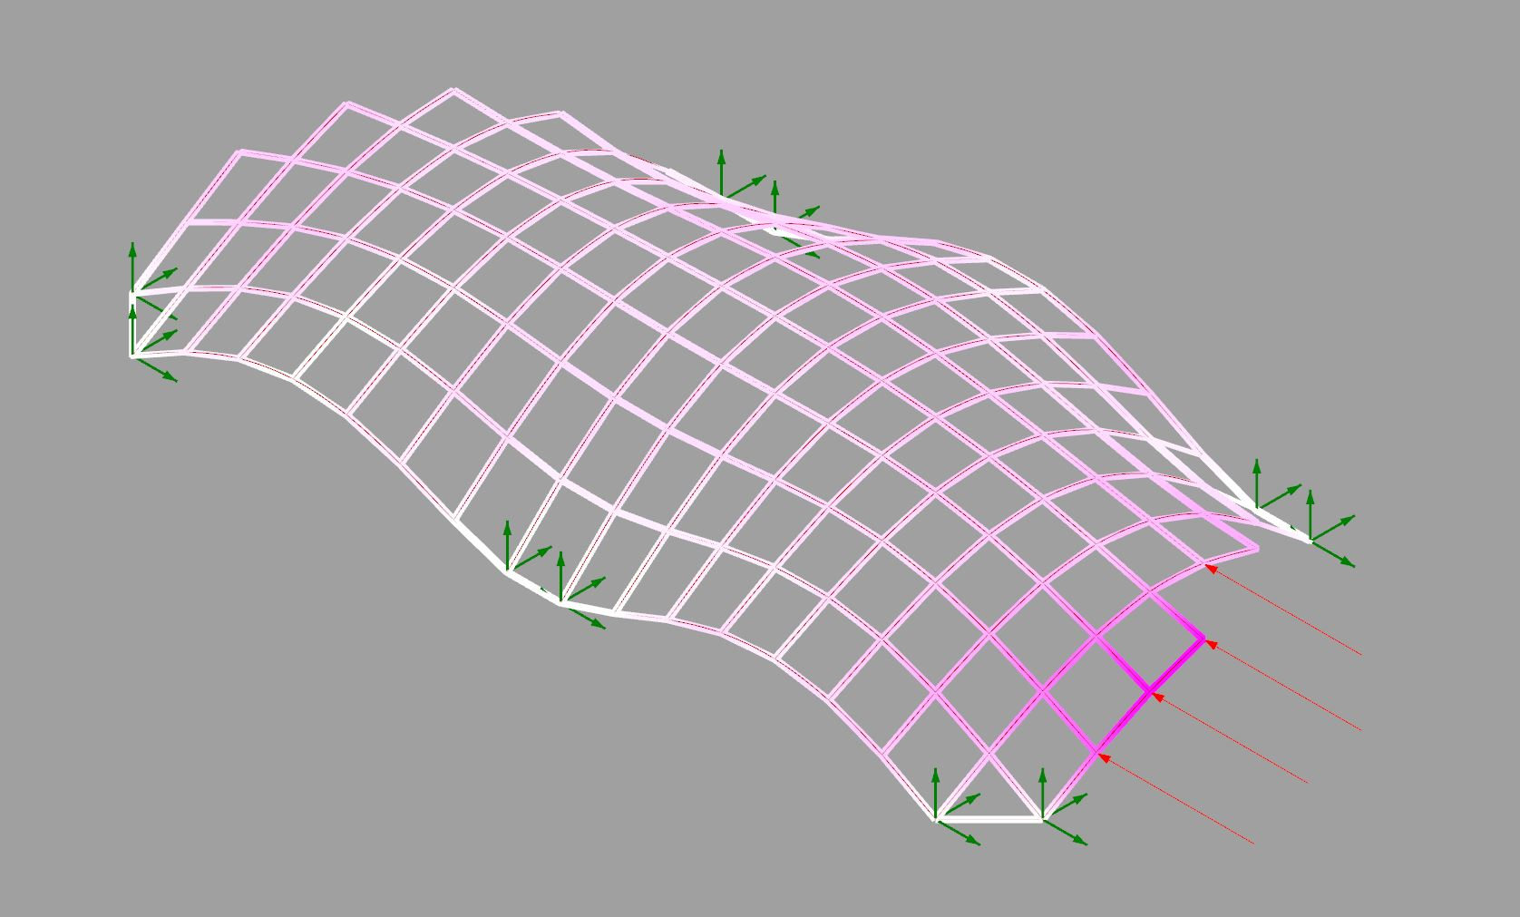
Lateral Displacement
Date: March 20 2017 Topic: Canopy Final
Maximum beam displacement: .57 inches
WEEK #

Slide 10
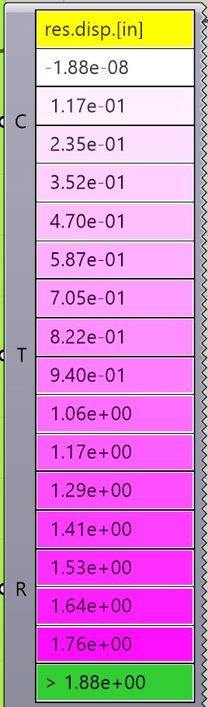
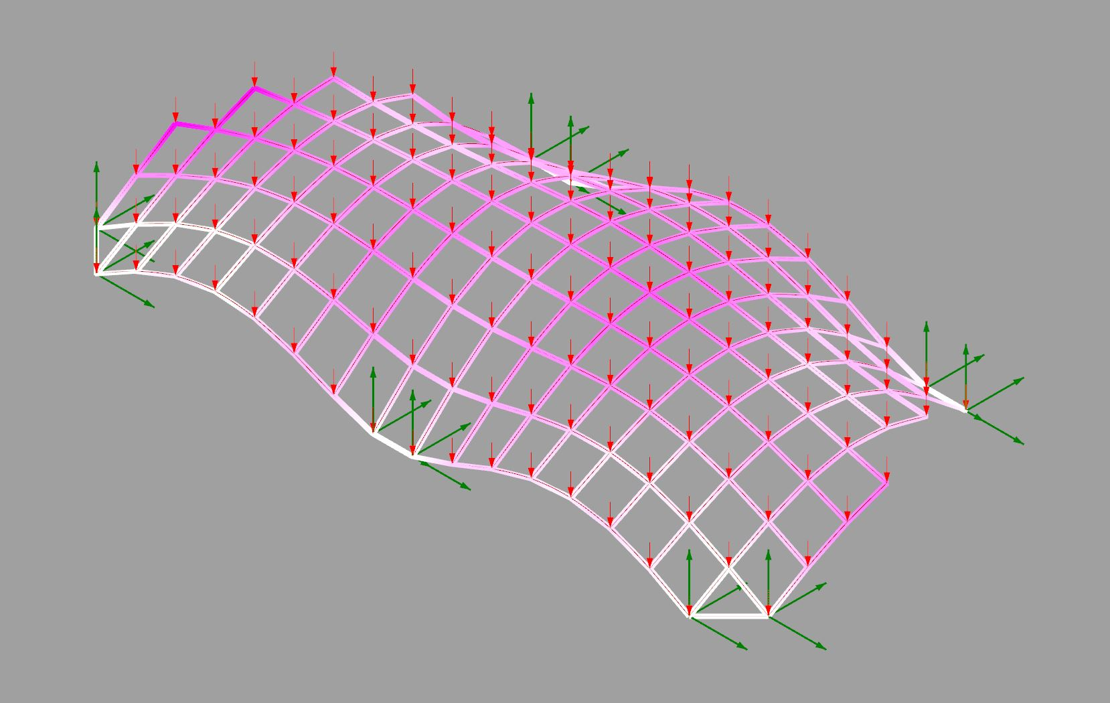
Gravity Displacement
Date: March 18 2017 Topic: Canopy Final
Maximum beam displacement: 1.6 inches
WEEK #

Slide 11
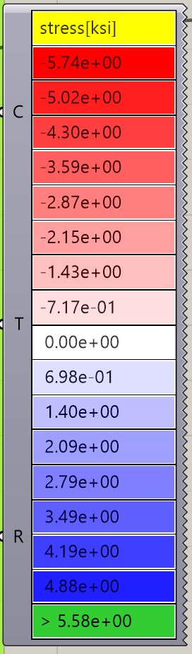
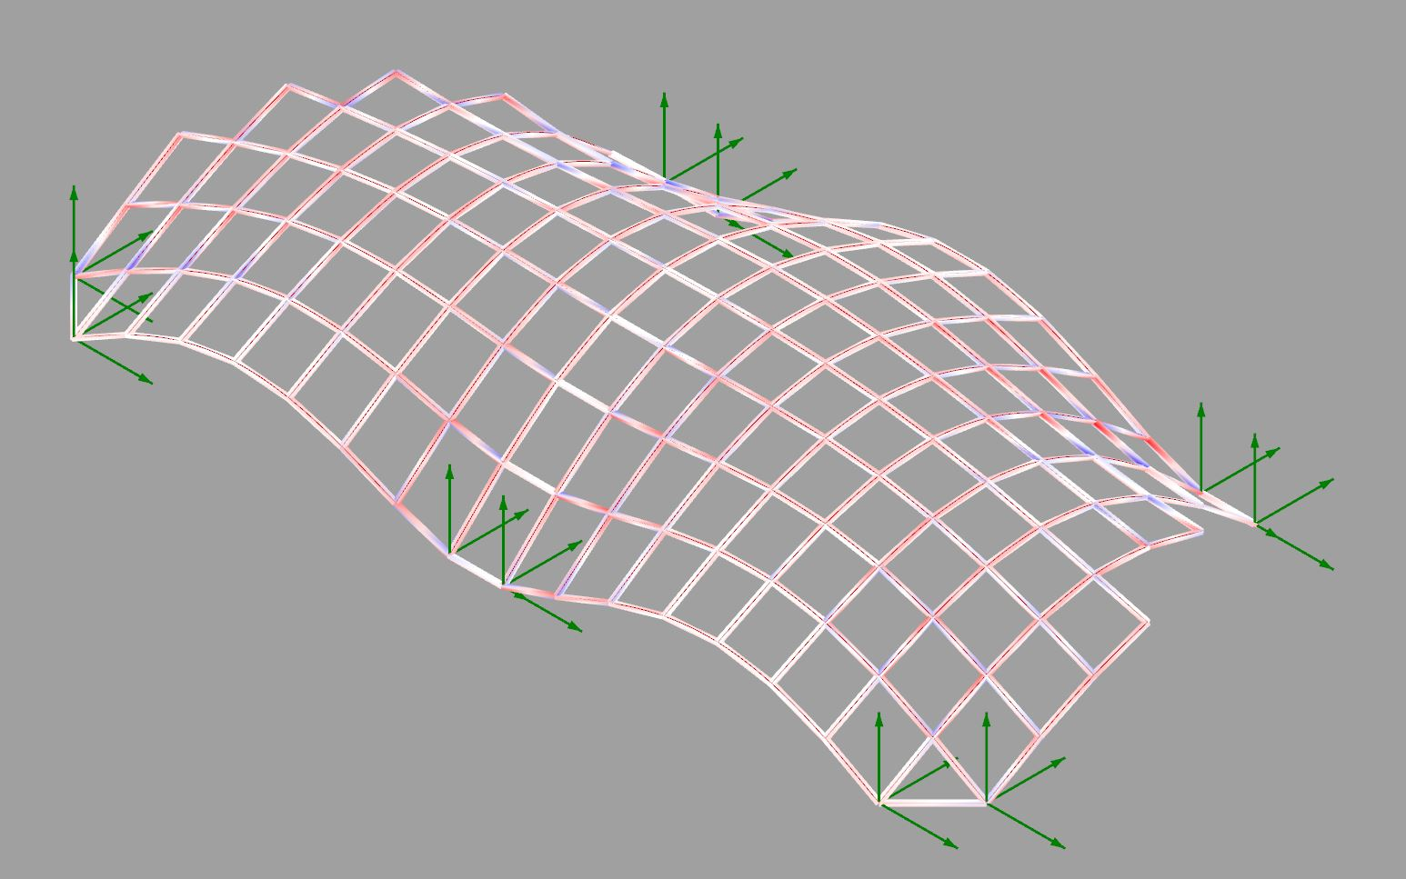
Axial Stresses
Date: March 18 2017 Topic: Canopy Final
Max Compression: 1.17 kips Max Tension: .15 kips
WEEK #

Slide 12
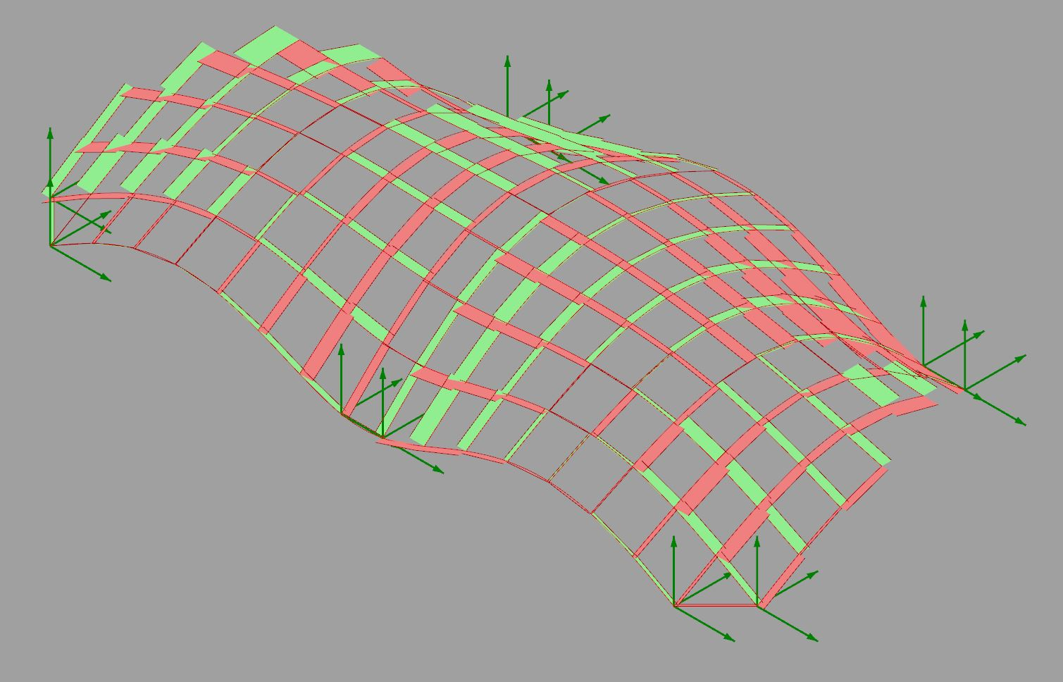
Shear Stresses
Date: March 18 2017 Topic: Canopy Final
Max Shear: .236 kips
Shear Y
Shear Z
WEEK #

Slide 13
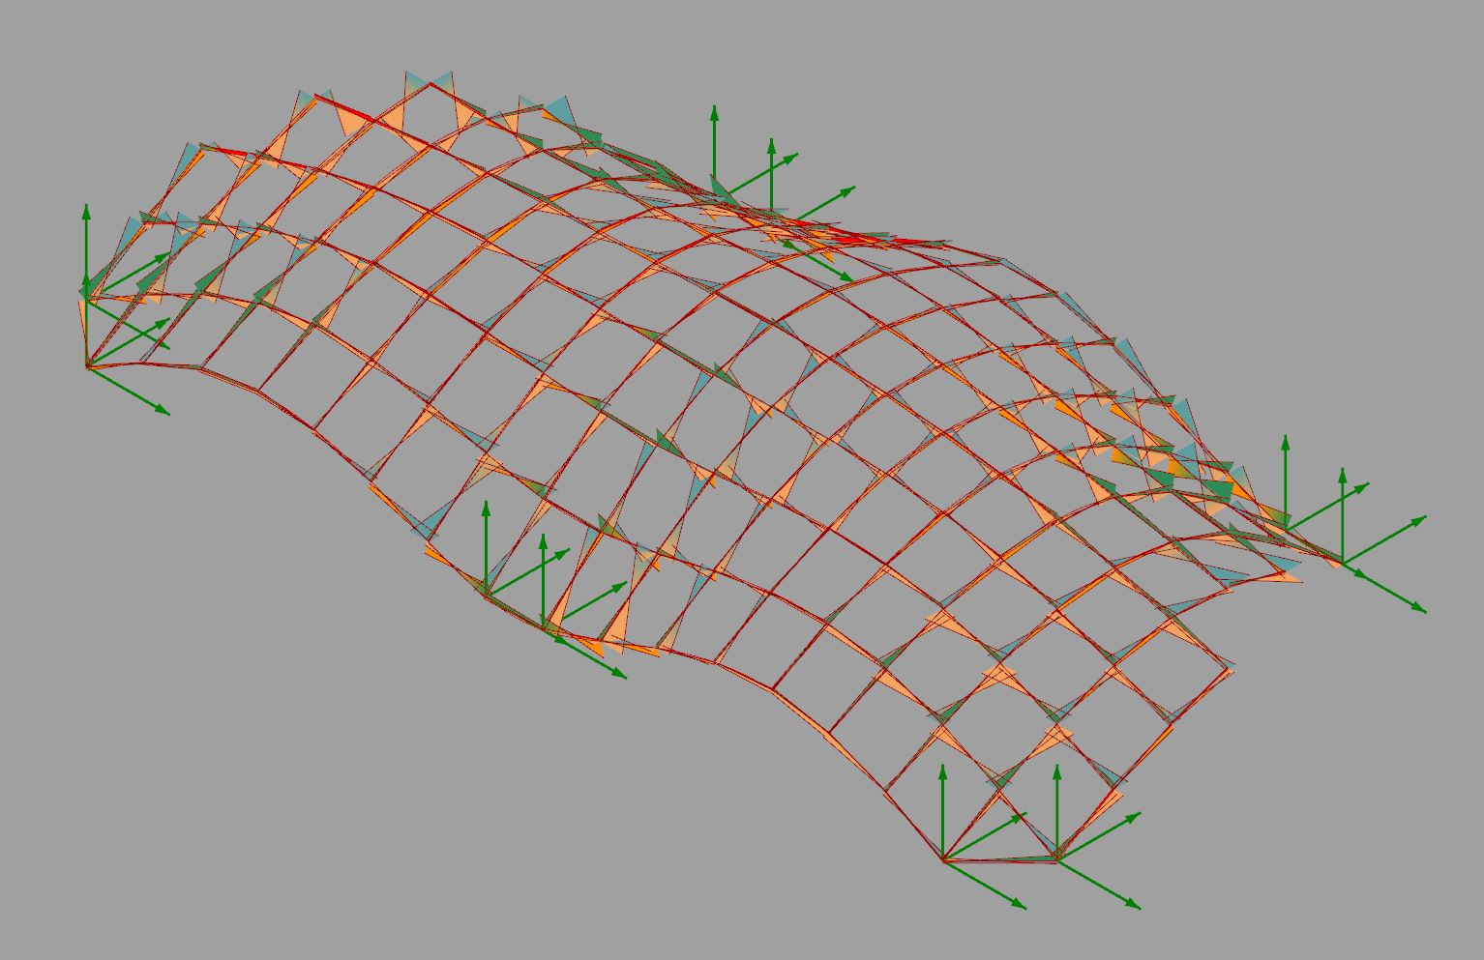
Moment Diagram
Date: March 18 2017 Topic: Canopy Final
Max moment: .277 kip-ft node 36
Moment Combined
Moment X
Moment Y
Moment Z
WEEK #

Slide 14
Bracing
Date: 3/20/17 Topic: Final Project
The Trondheim Gridshell utilizes cross bracing in order to keep the form in place as it does not have a rigid connection to the ground. The 5-Point Canopy does not require bracing due to the fact that the form is firmly held in place by the concrete base. Bracing is also not necessary due to the fact that lateral loads do not cause enough deflection on the structure to require extra bracing.
>>Josh Rosenthal

Slide 15
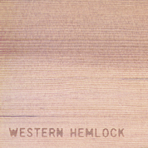
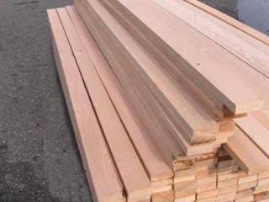
Material:
Western Hemlock
Date: March 20
Topic: Final Presentation
1x2 Western Hemlock is the material we would choose from the list of available materials for this structure. The 1x2 section is the most appropriate material choice (in comparison to the the 4x4 or plywood panels) for a lattice shell. Western Hemlock usually has a straight grain, which will be helpful to transfer bending and lateral forces. It is not a very durable wood, and is vulnerable to insect attack, so it will need to be off the ground and covered. The species is grown in Oregon and Washington and commonly used in construction, so it hypothetically it could be sourced locally.
Our canopy will be made from some water resistant fabric, ideally translucent. That exact type of fabric is currently being researched as water resistance and light transmission seem to be at odds. We may try shower curtain fabric.
https://www.commerce.alaska.gov/web/portals/6/Images/commercial_forest_species_04.jpg
http://www.kalesnikoff.com/wp-content/uploads/2013/12/album-hemlock-2-1024x787.png
http://www.greatnorthernlumber.com/gnl/wp-content/uploads/westhemlock2.jpg
http://www.coniferousforest.com/wp-content/uploads/2017/01/Western-Hemlock-Tree.jpg
WEEK # 6

Slide 16
Properties of Western Hemlock
Date: 3/20/17 Topic: Final Presentation
WEEK #

Slide 17
Process Work
Date: 20 March
Topic: Final Presentation
Since the second iteration, we decided to focus on grid shell system. We switched from karamba form finding to kangaroo form finding, and developed construction sequence based on Trondheim gridshell research.

Slide 18
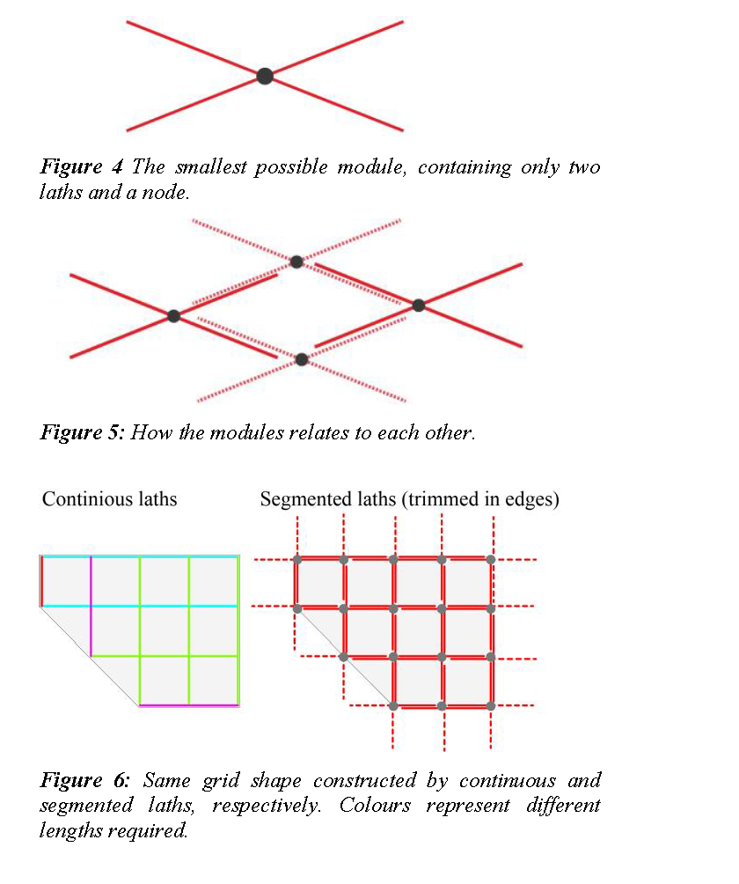
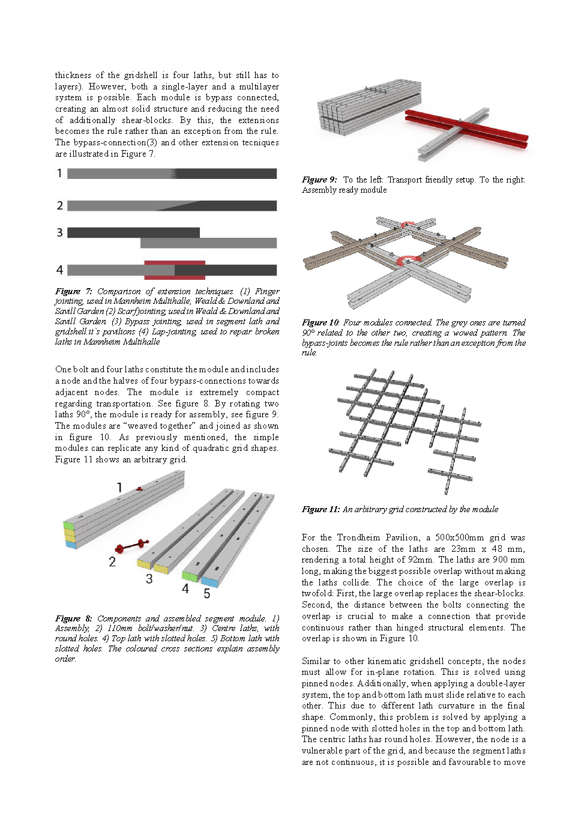
Research
Date: 20 Mar 2017 Topic: Final Presentation
LEARNING OBJECTIVE Canopy Project
The Trondheim gridshell research paper is our main reference for construction sequence and connection detail.
The basic module is four laths intercrossed in the center of the wide surface. Combination of these basic modules is creating continuous grid system.
<< Screenshot from Trondheim Gridshell Research Paper
WEEK 9

Slide 19
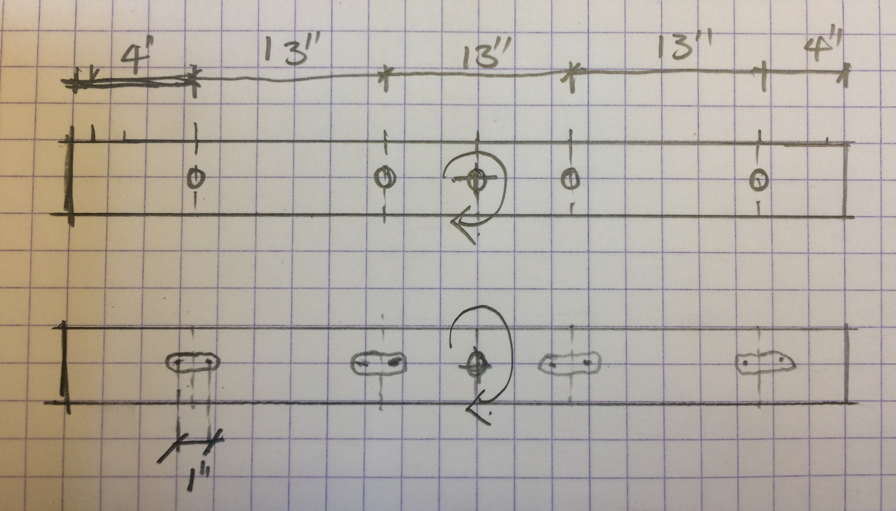
Research
Date: 6 Mar 2017 Topic: Canopy Second Interation
LEARNING OBJECTIVE Canopy Project
Each module is made with four ¼ inch thick 4 ft 1*3 wood interconnect in the center of wide surface.Each lath have five wholes for connection, and spaced in certain distances as hand sketch on the upper right.
Two out of four lathes with five wholes are having same diameter for each whole, and the other two out of four lathes have four 1 inch wide slots and a center whole for interconnect. These slots allow the module have better bending.
<< Screenshot from Trondheim Gridshell Research Paper
WEEK 9

Slide 20
Elements
Date: 20 Mar 2017 Topic: Final Presentation
Each of the two pieces is made out of one four foot piece of 1”x3” hemlock. One piece is drilled with all pin holes for connections. The other piece has one pin connection in the center for rotation. The other four connections are slotted to allow for extra bending in the connection.
WEEK 6

Slide 21
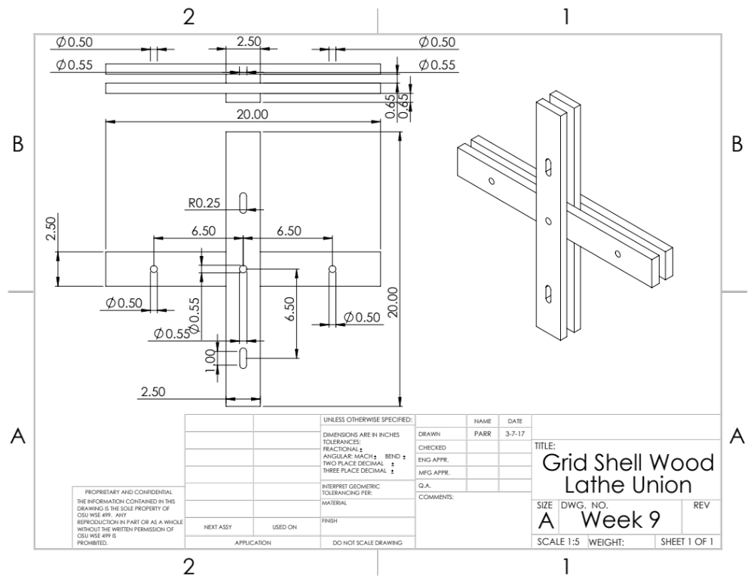
Module Connection
Date: 3/20/17 Topic: Final Presentation
The wooden members of the grid shell will be connected with 3/8-16 x3.5” and 1/2-13x3.5” stainless steel fasteners. (316)
The 1/2” fasteners will be used at the center of each module for the pivot point. This will be a long shoulder short thread style of fastener to provide a smooth shank for the timber to rotate on.
The 3/8” fasteners will be used at all other lathe fastening location along with fender washers and nylocks
>>Images by Tygh Parr

Slide 22
Module
Date: 20 Mar 2017 Topic: Final Presentation
LEARNING OBJECTIVE Canopy Project
A singular module consists of four pieces, two of each type. The two slotted pieces sandwich the two pin connection pieces. This way, each arm has a connection with a pin and a slot to allow the bolt connector to move and allow for extra bending.
WEEK 6

Slide 23
System
Date: 20 Mar 2017 Topic: Final Presentation
LEARNING OBJECTIVE Canopy Project
A system of four creates the beginning of the grid shell. As the grid shell moves away from the pin connection, each piece attaches on the lower side of the last piece. This automatically sets the bend for the grid shell. The connection to the ground is a pin connection to allow for rotation when bending the grid shell to shape.
WEEK 6

Slide 24
Bending Test
Date: 20 Mar 2017 Topic: Final Presentation
WEEK 6

Slide 25
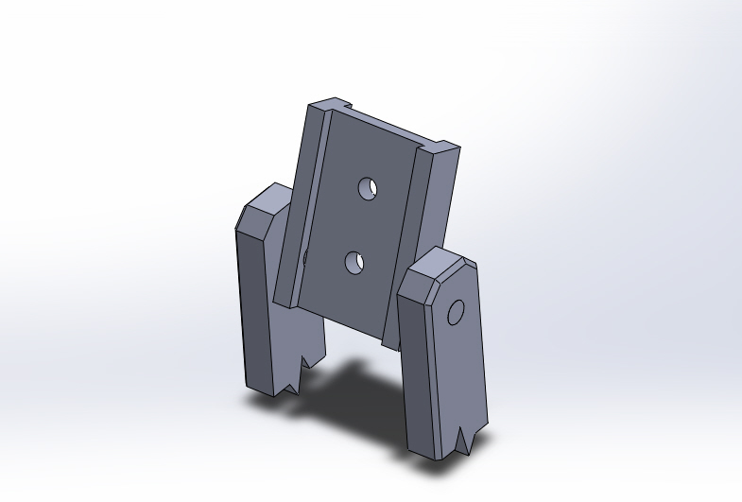
Foundation Connection
Date: 3/20/17 Topic: Timber Tectonics Final
The 5-point canopy will be connected to its foundation piers by 10 pined steel plates. Each connection point of the canopy will be comprised of the lattice of the gridshell clamped by the use of through bolting to the connections plate. The pin will resist the outward thrust force of the canopy while allowing the bent geometry of the canopy some position tolerance.
>>Image by Tygh Parr

Slide 26
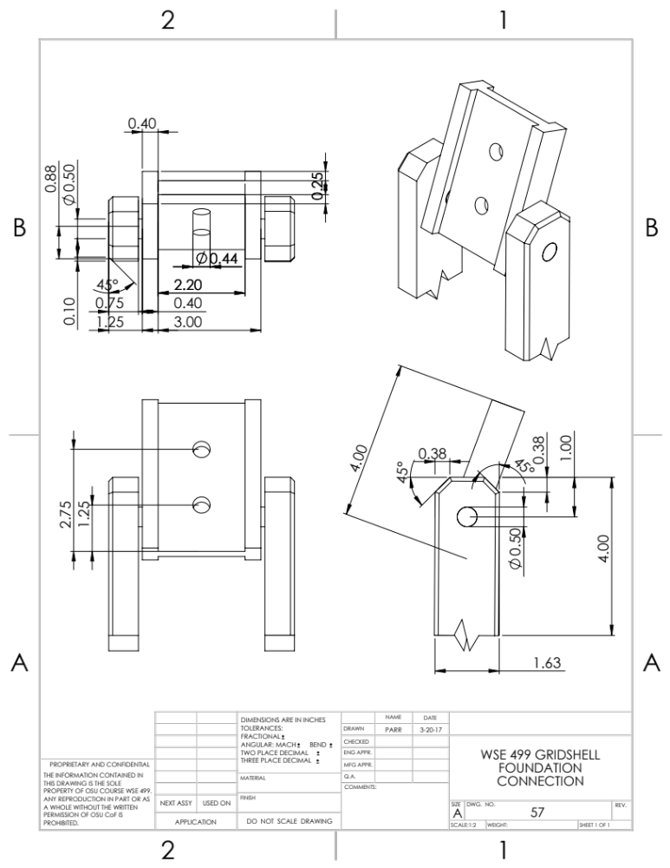
Foundation
Connection
Date: 3/20/17 Topic: Timber Tectonics Final
The pined connections will be cast into the foundation piers when they are poured. The grid shell lattice will be secured onto the plate with the same 3/8”-16 stainless fasteners as the modules are constructed with.
>>Images by Tygh Parr

Slide 27
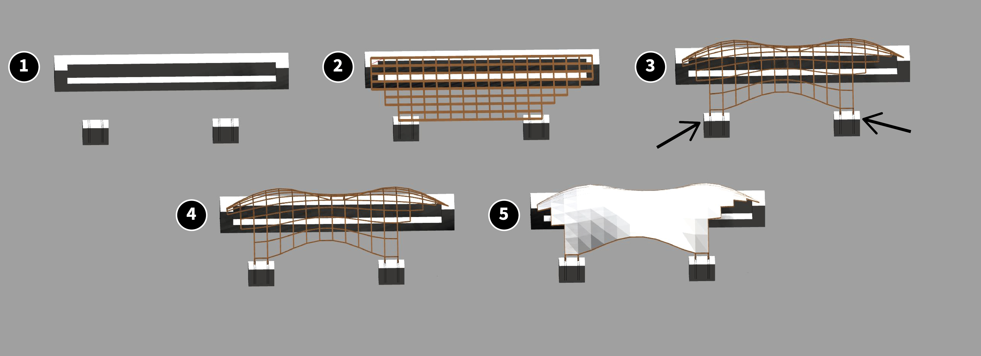
Construction Diagram
Date: 3/20/17 Topic: Final Presentation
The concrete base is constructed
The canopy is laid out flat on top of the concrete base
The canopy is pushed/pulled into place
A finalized form is produced and secured to the base
The rain protection canopy is added
>>Josh Rosenthal

Slide 28
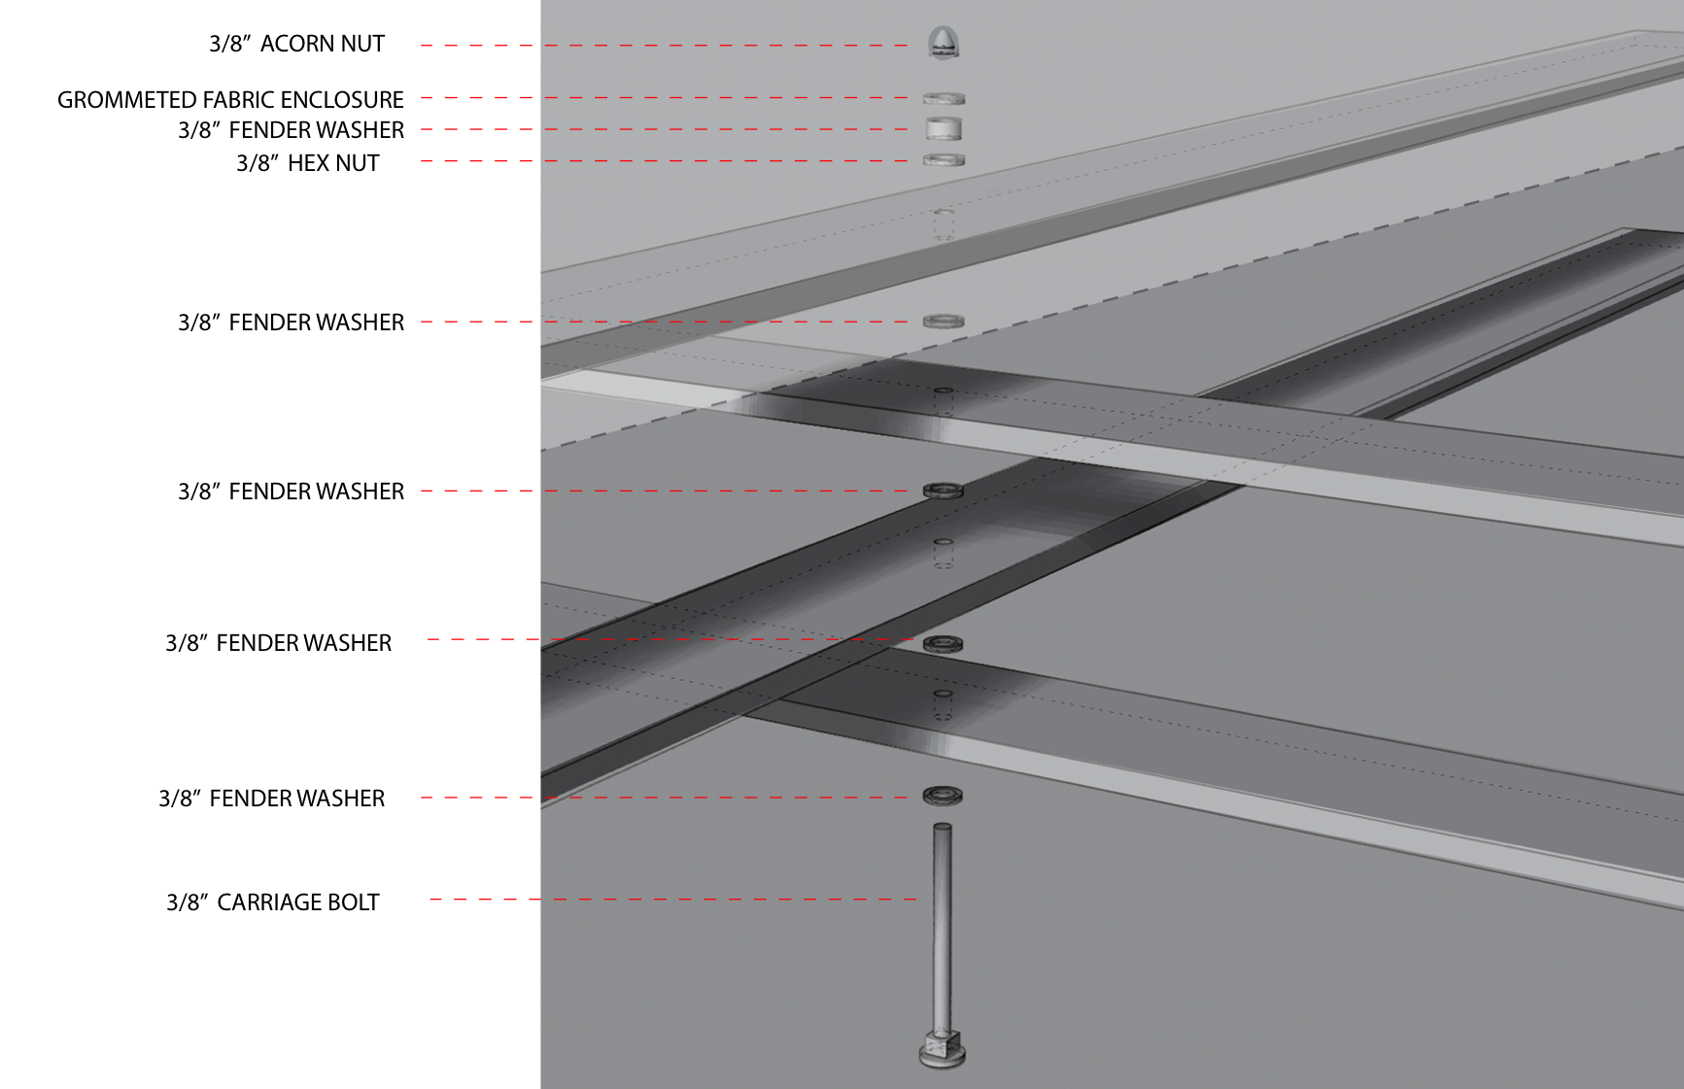
Module Connection to
Fabric Enclosure
Date: March 20 2017 Topic: Final Presentation
A square shouldered carriage bolt is used to connect
the four laths and fabric enclosure.
The bolt is inserted from the bottom of the assembly and fixed with a hex nut on top.
Once the final form is achieved, the grommetted fabric enclosure is draped over the top of the structured and secured with acorn nuts.

Slide 29
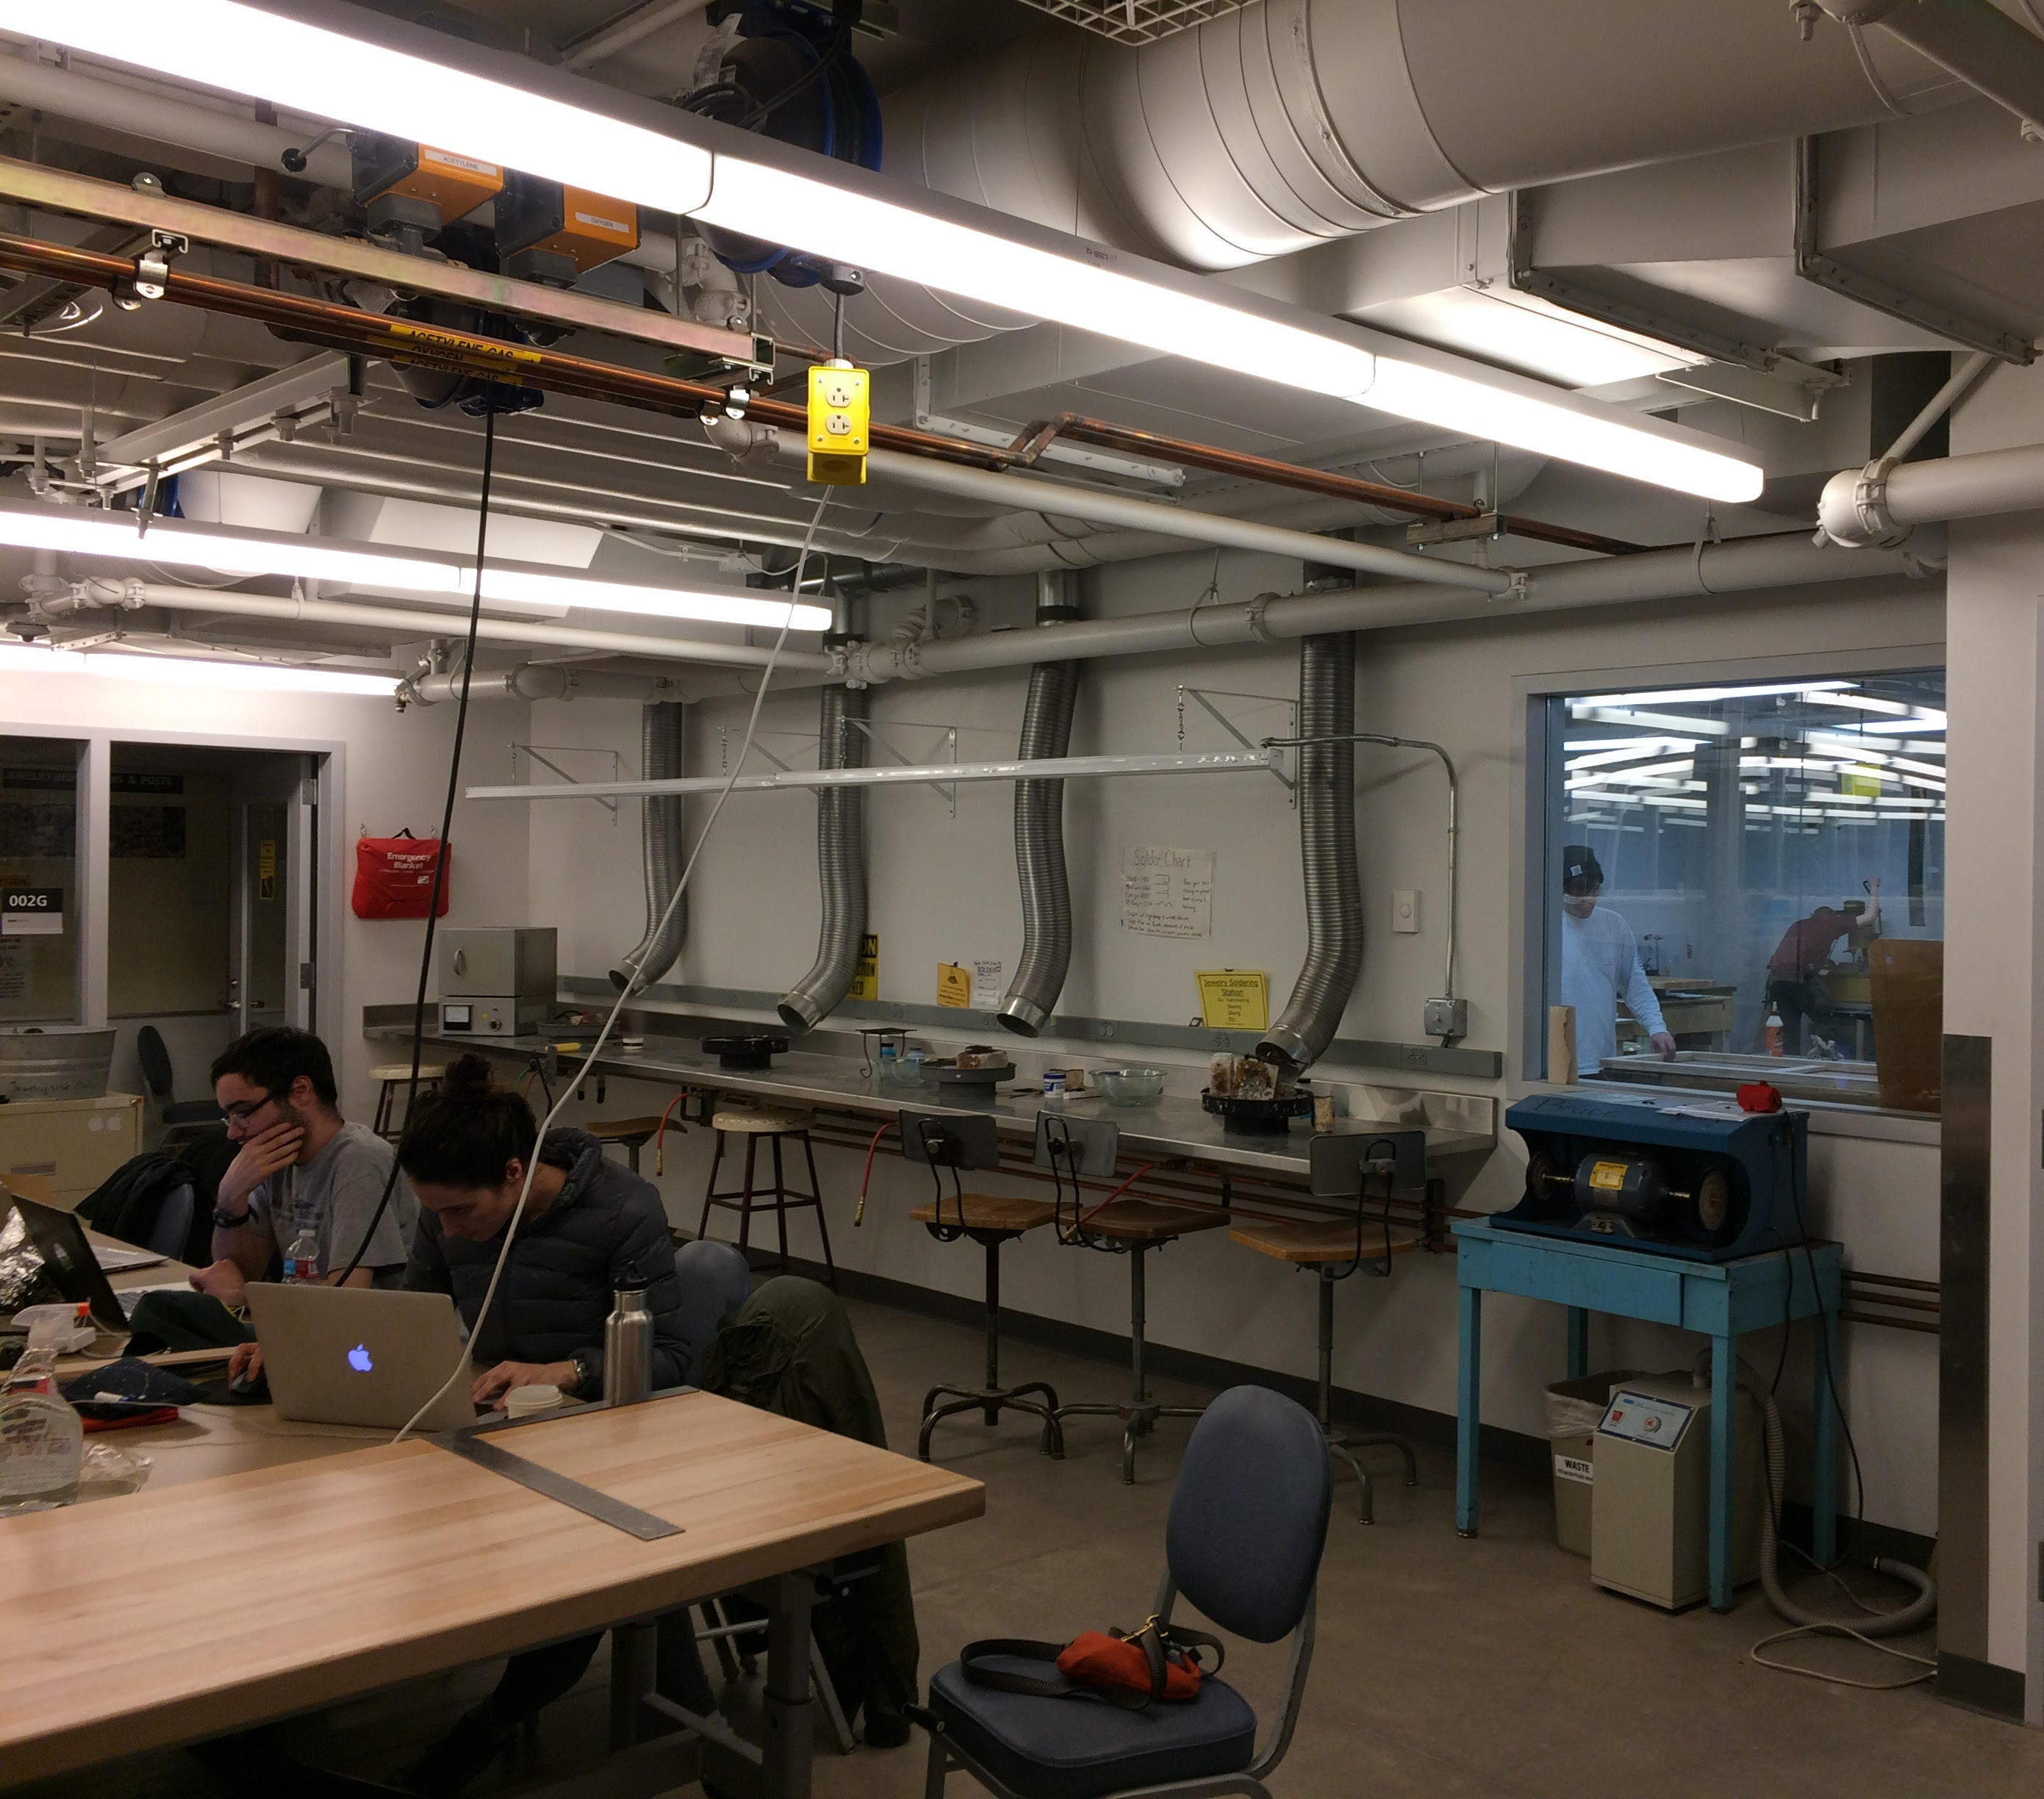
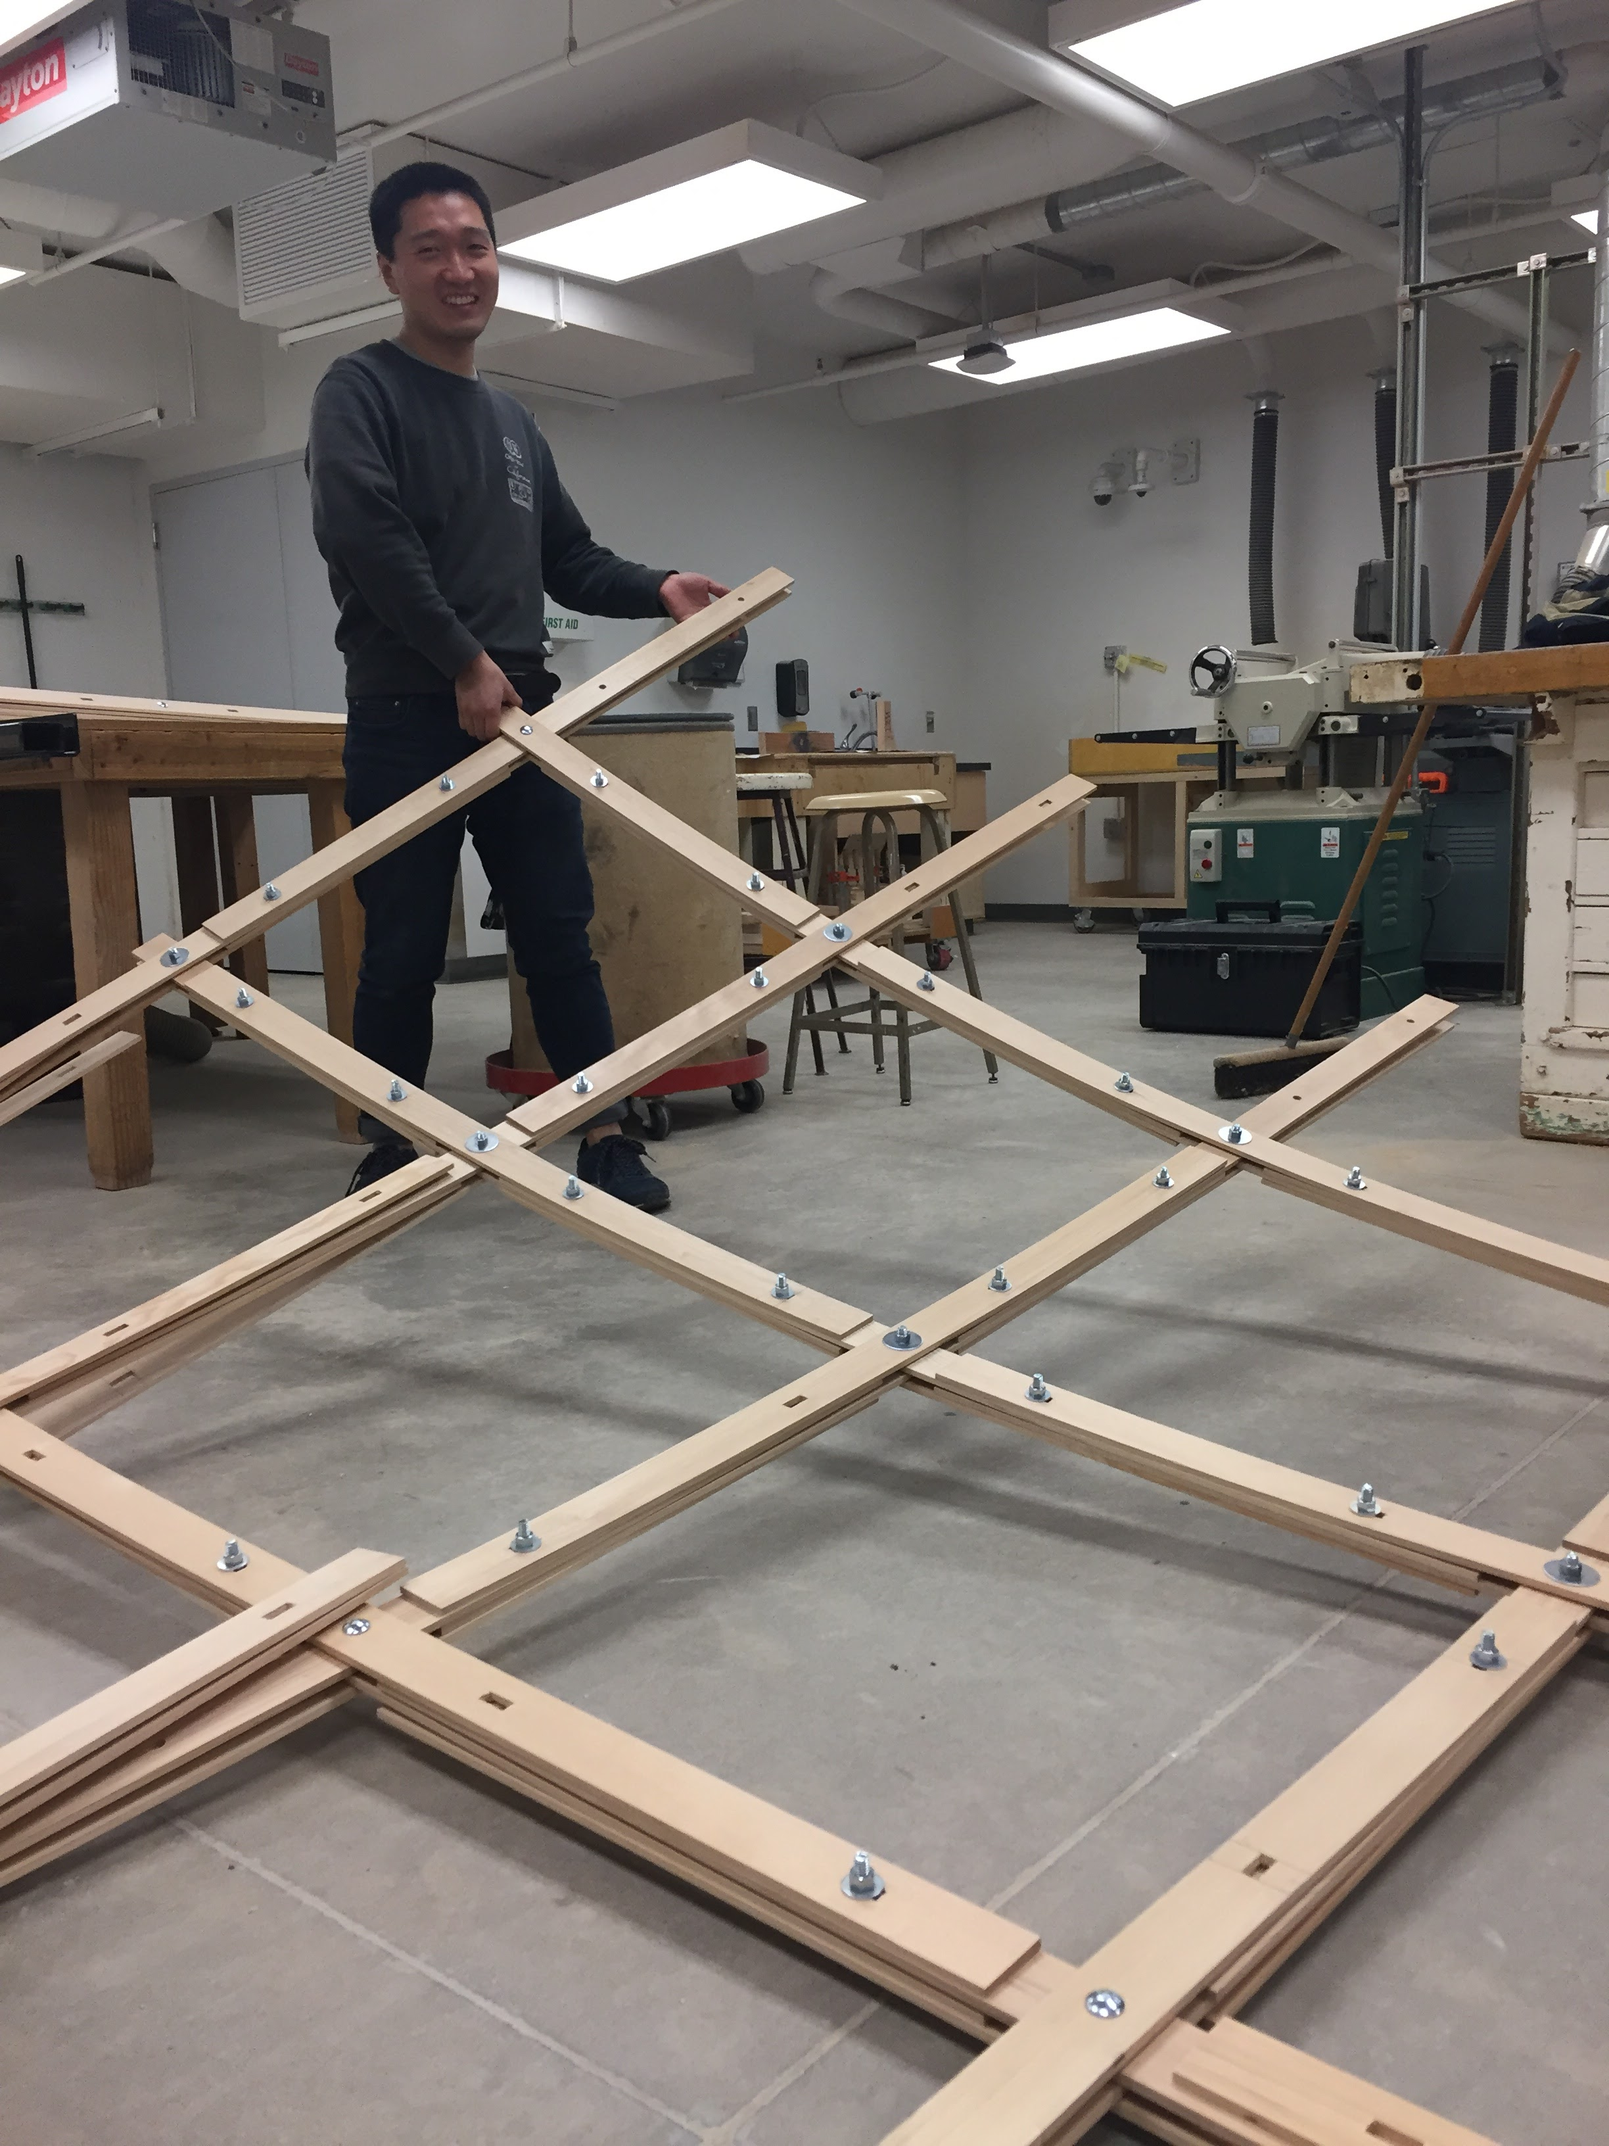
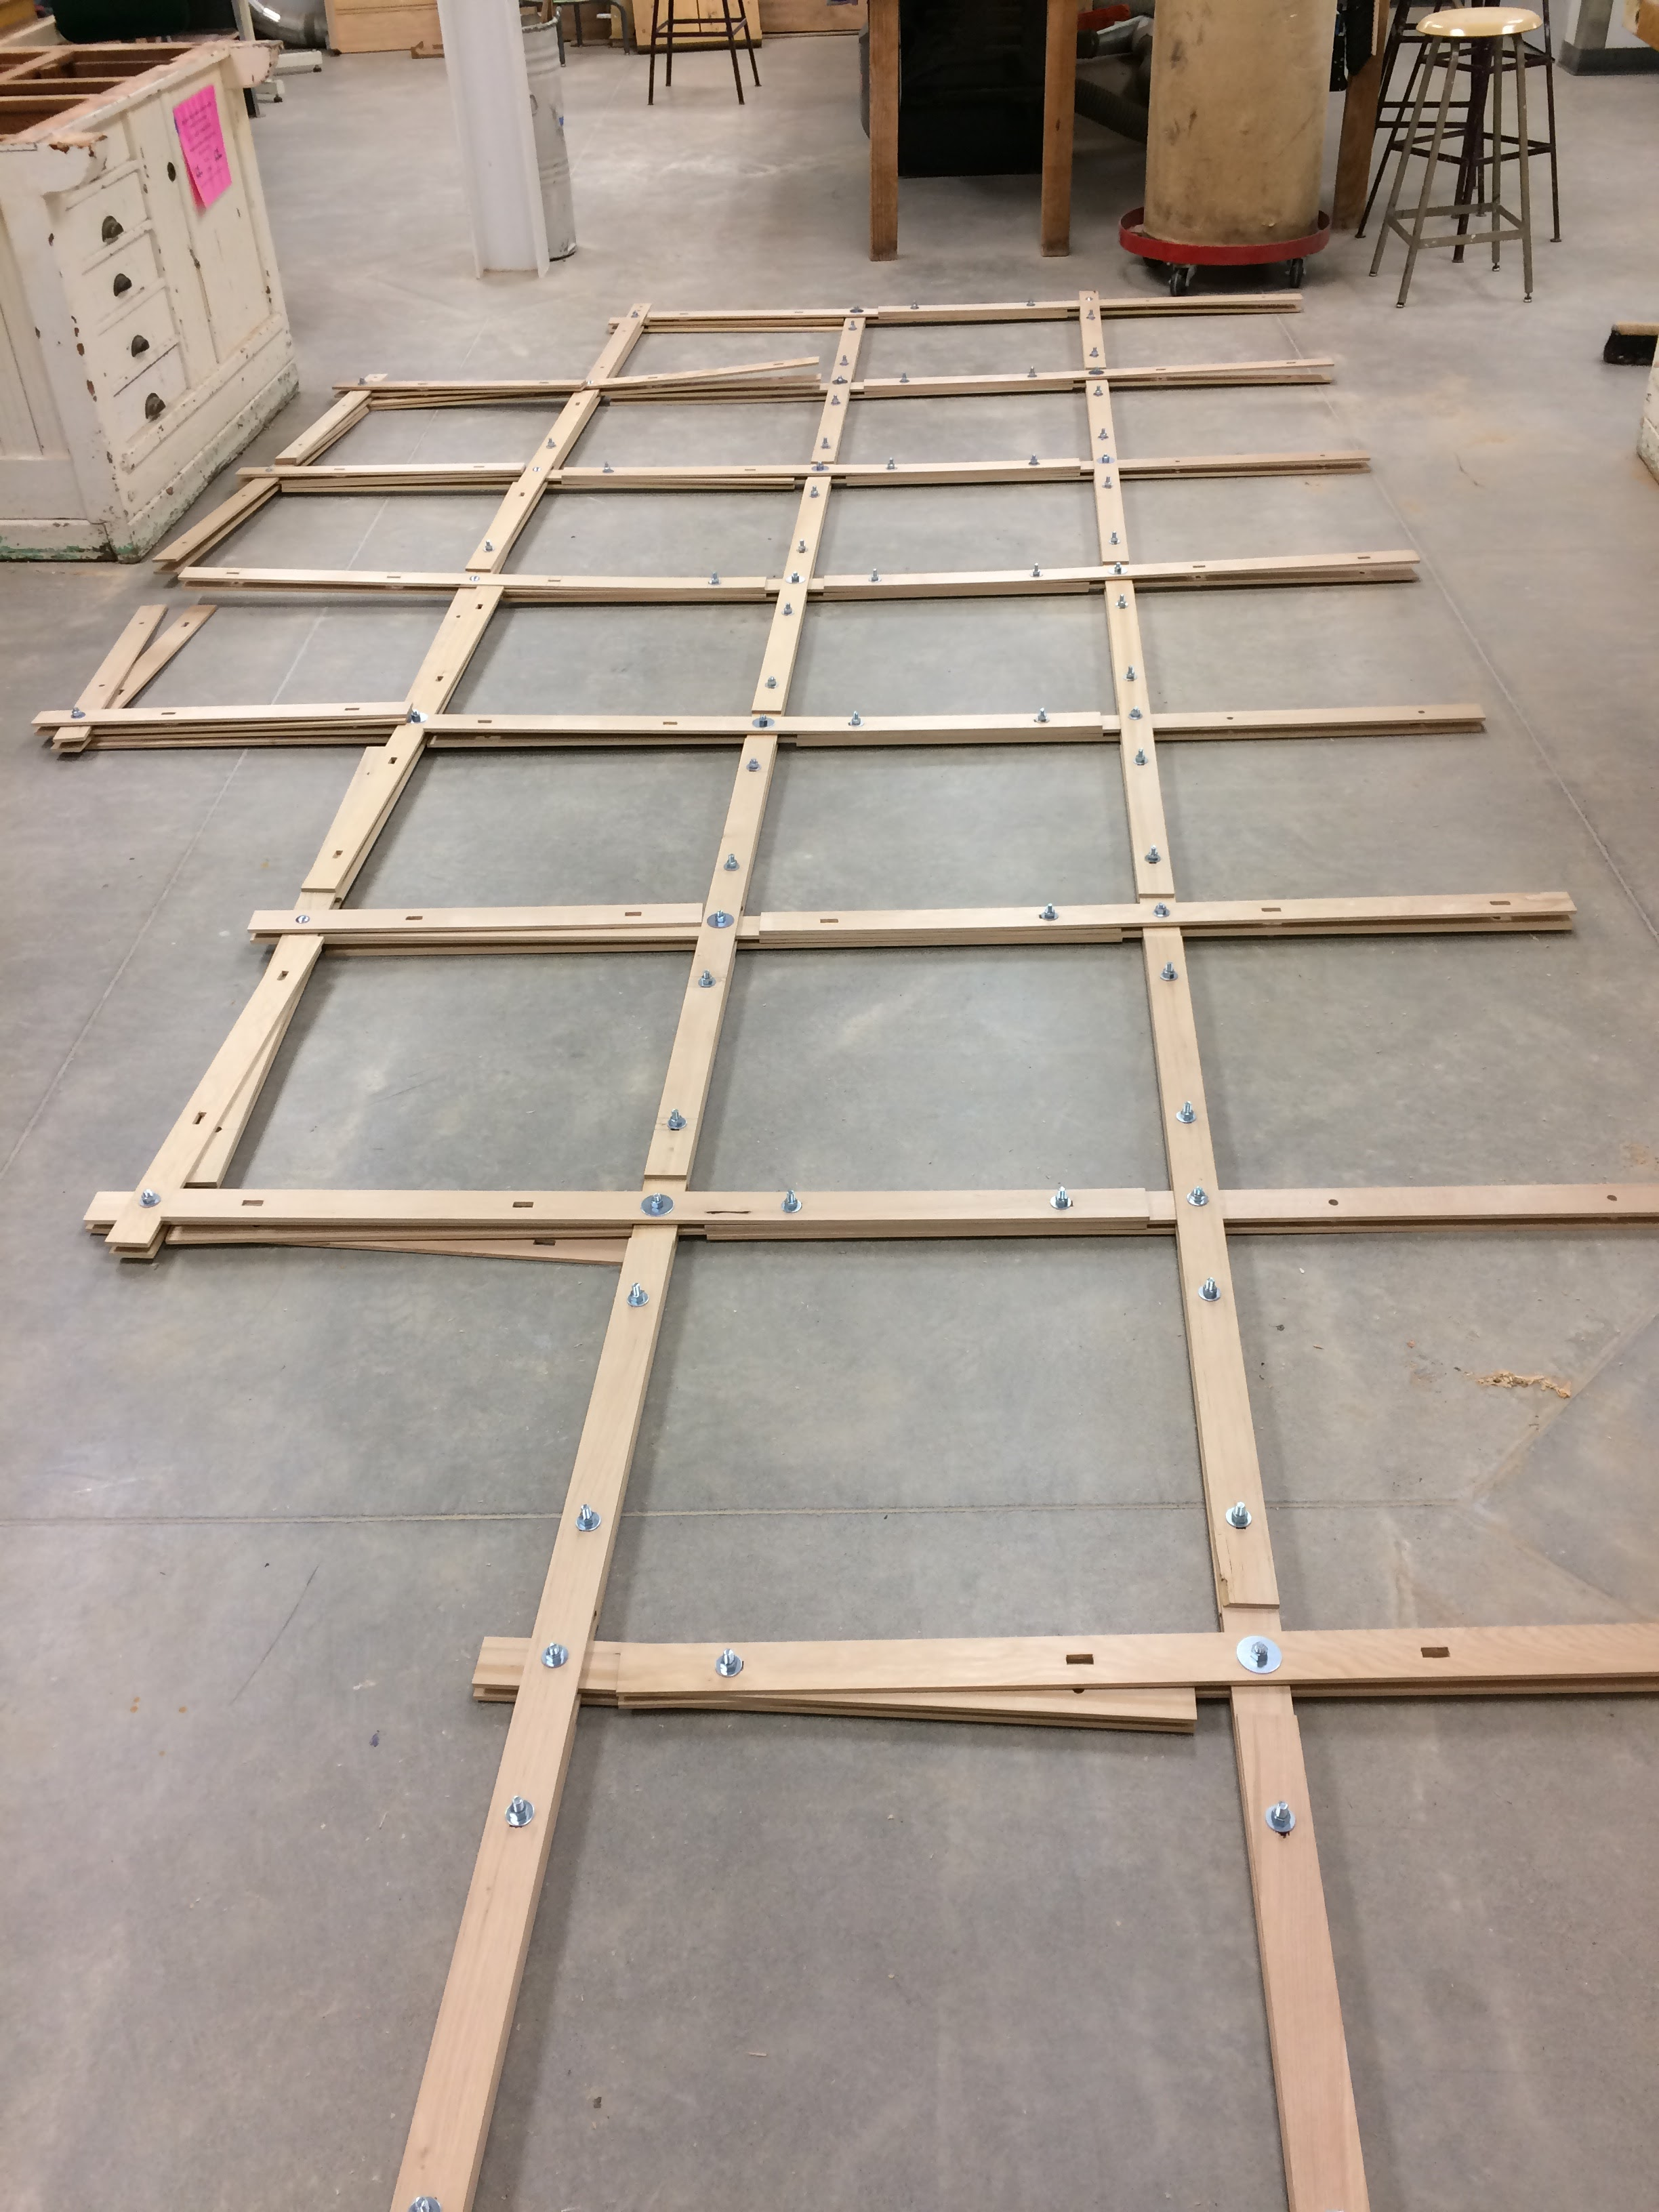
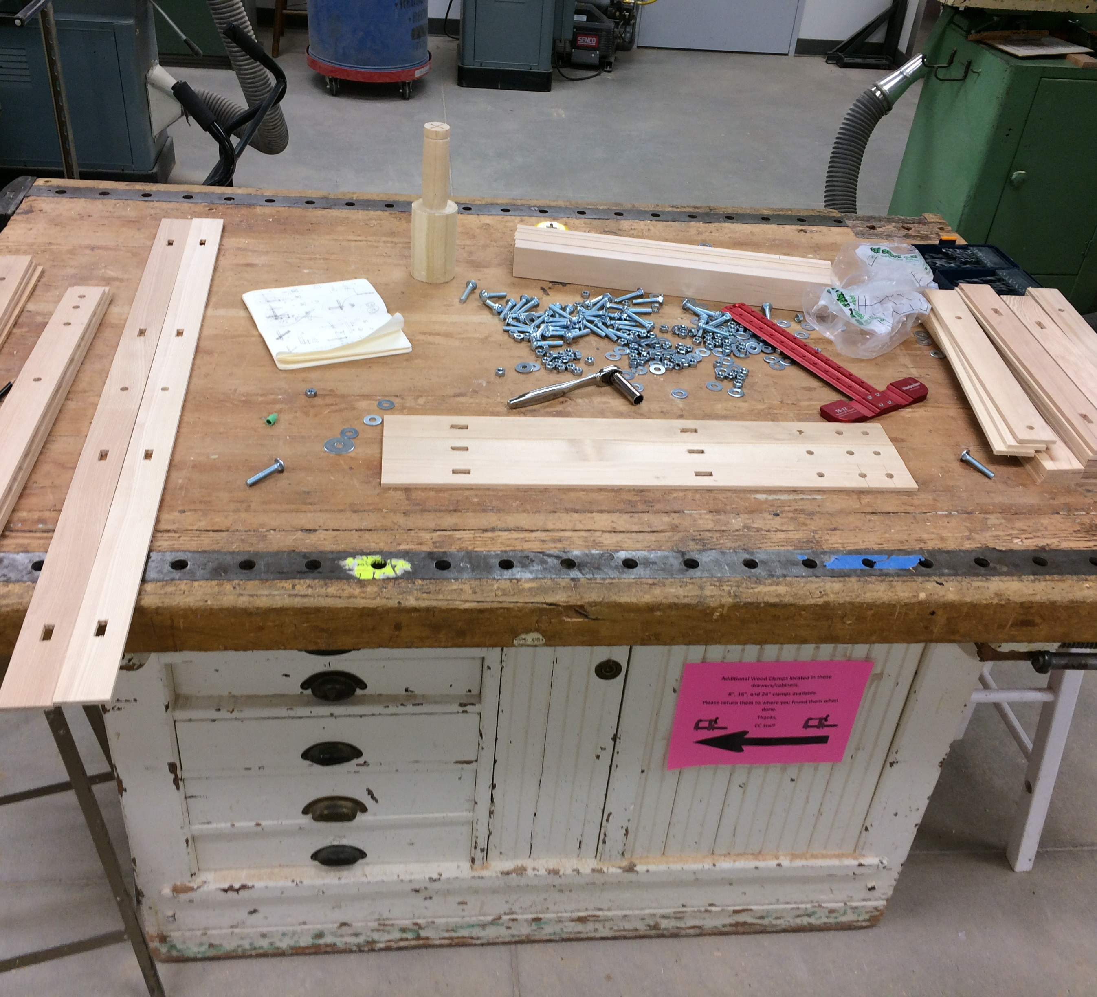
Work Process
Date: March 19 2017 Topic: Canopy Final
WEEK #

Slide 30
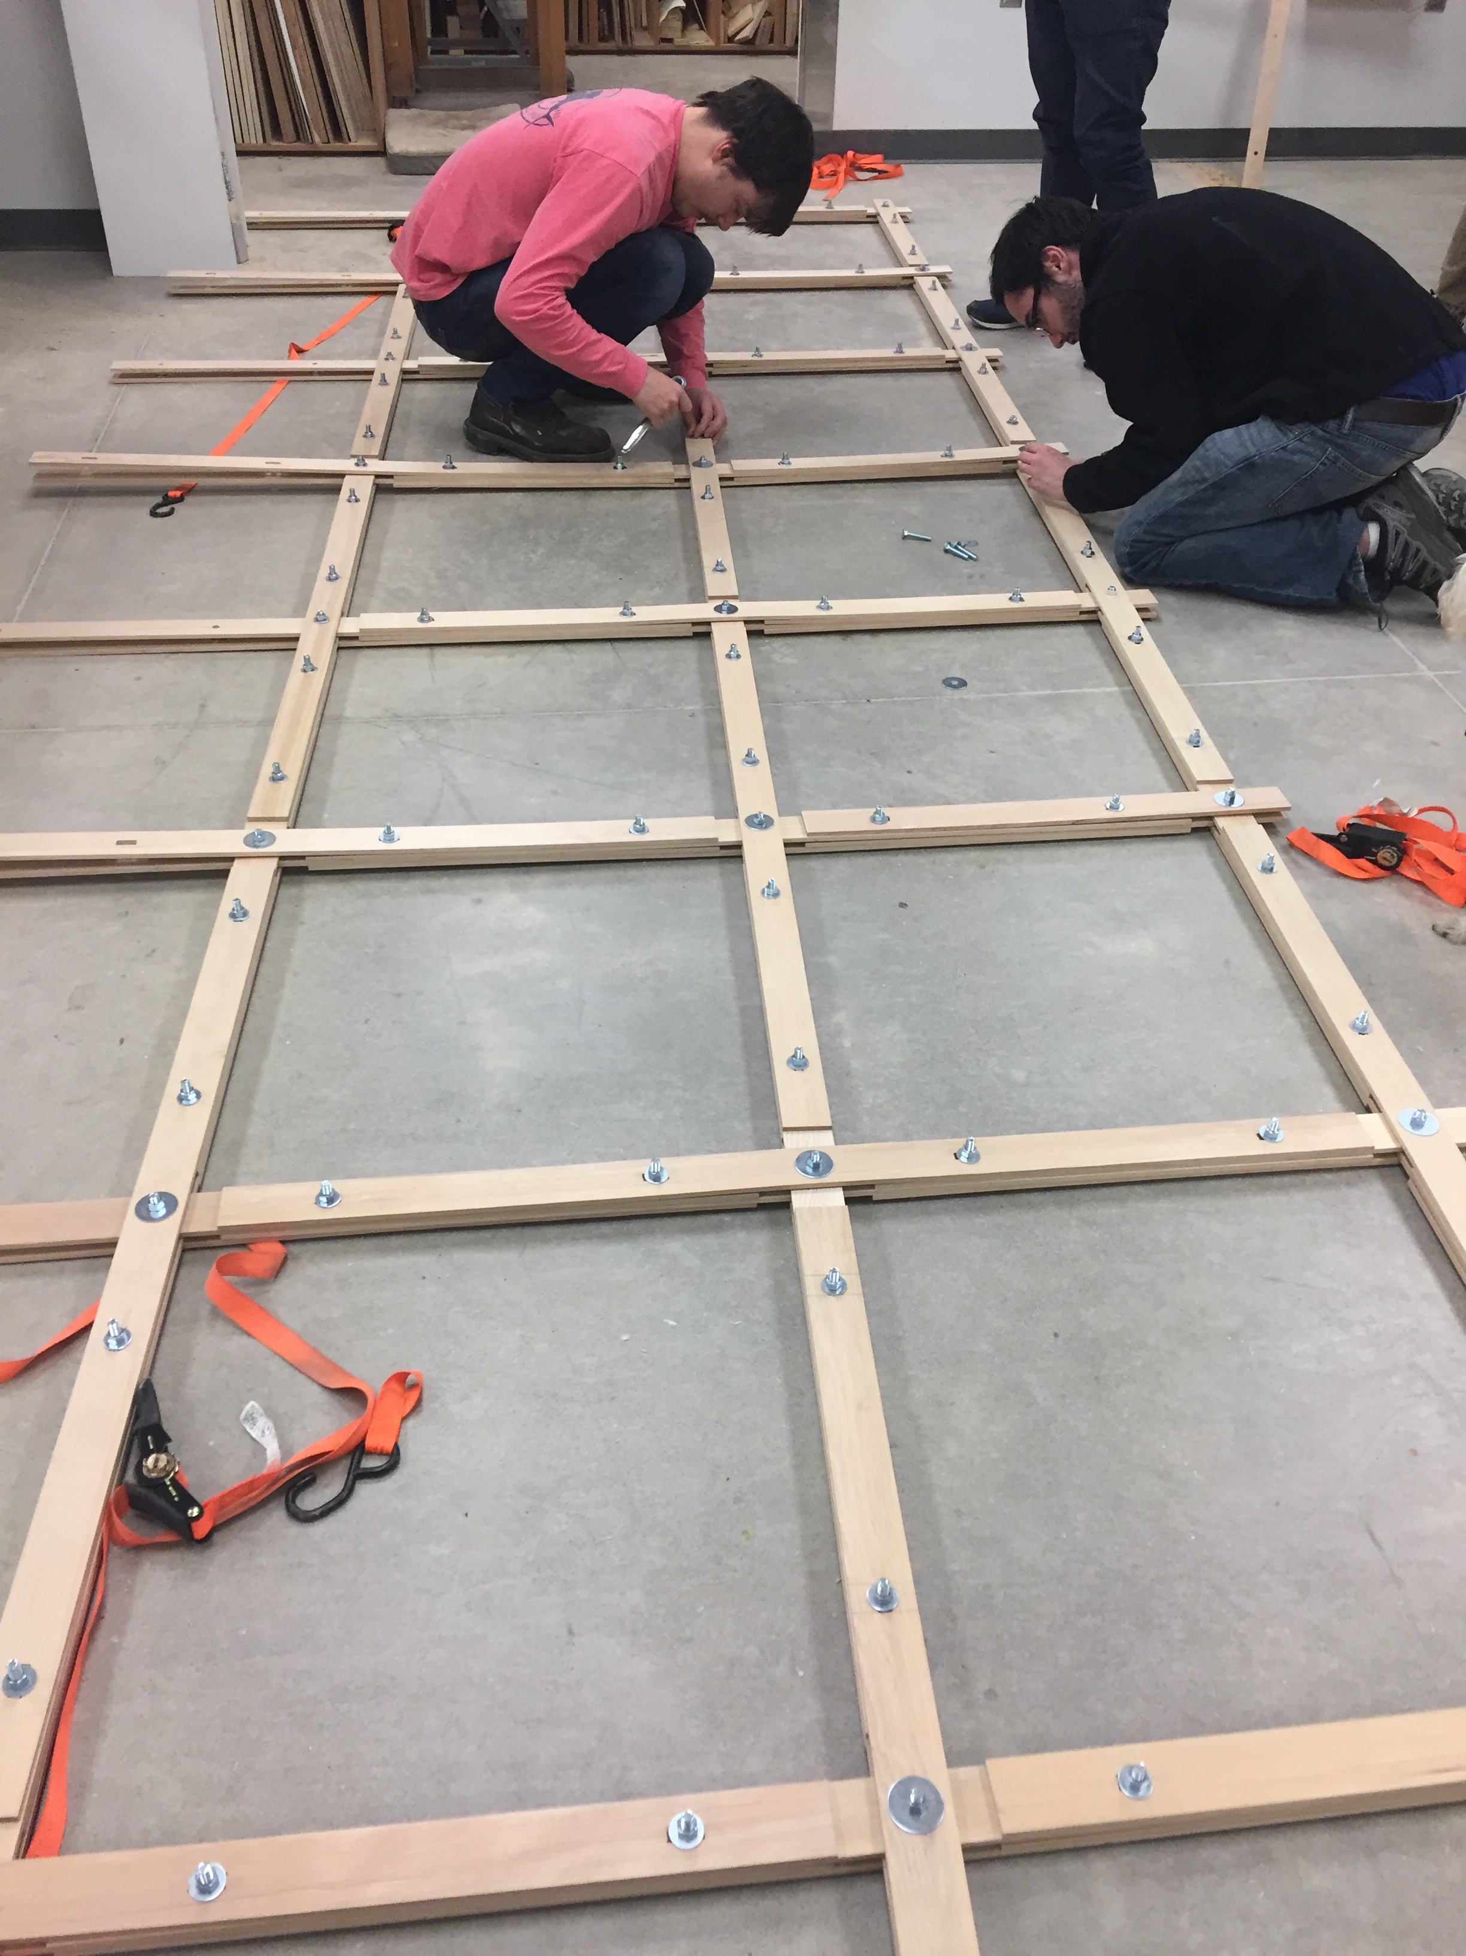
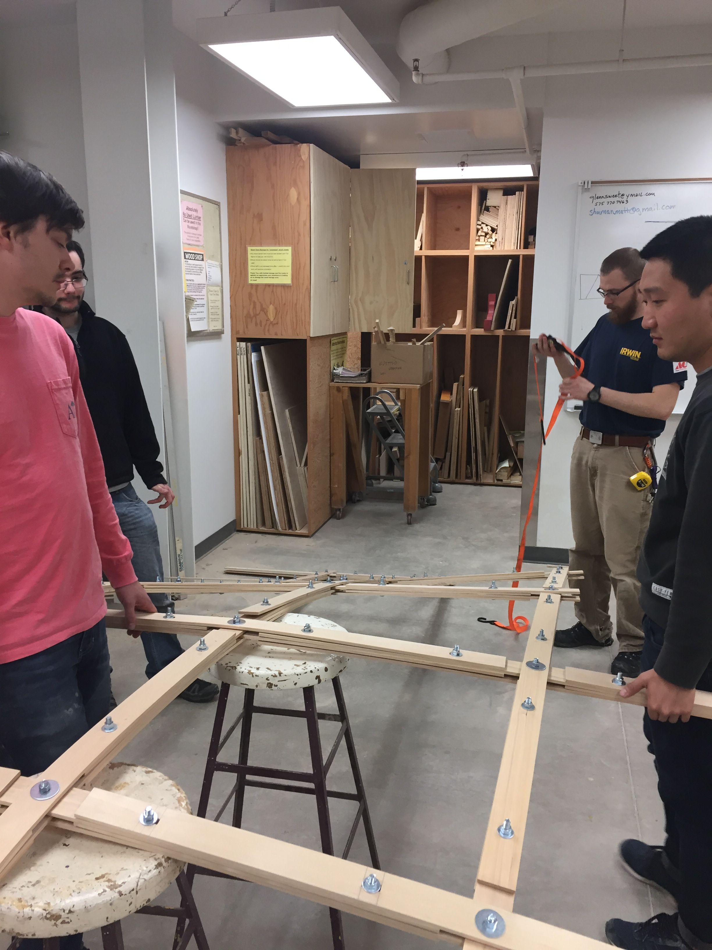
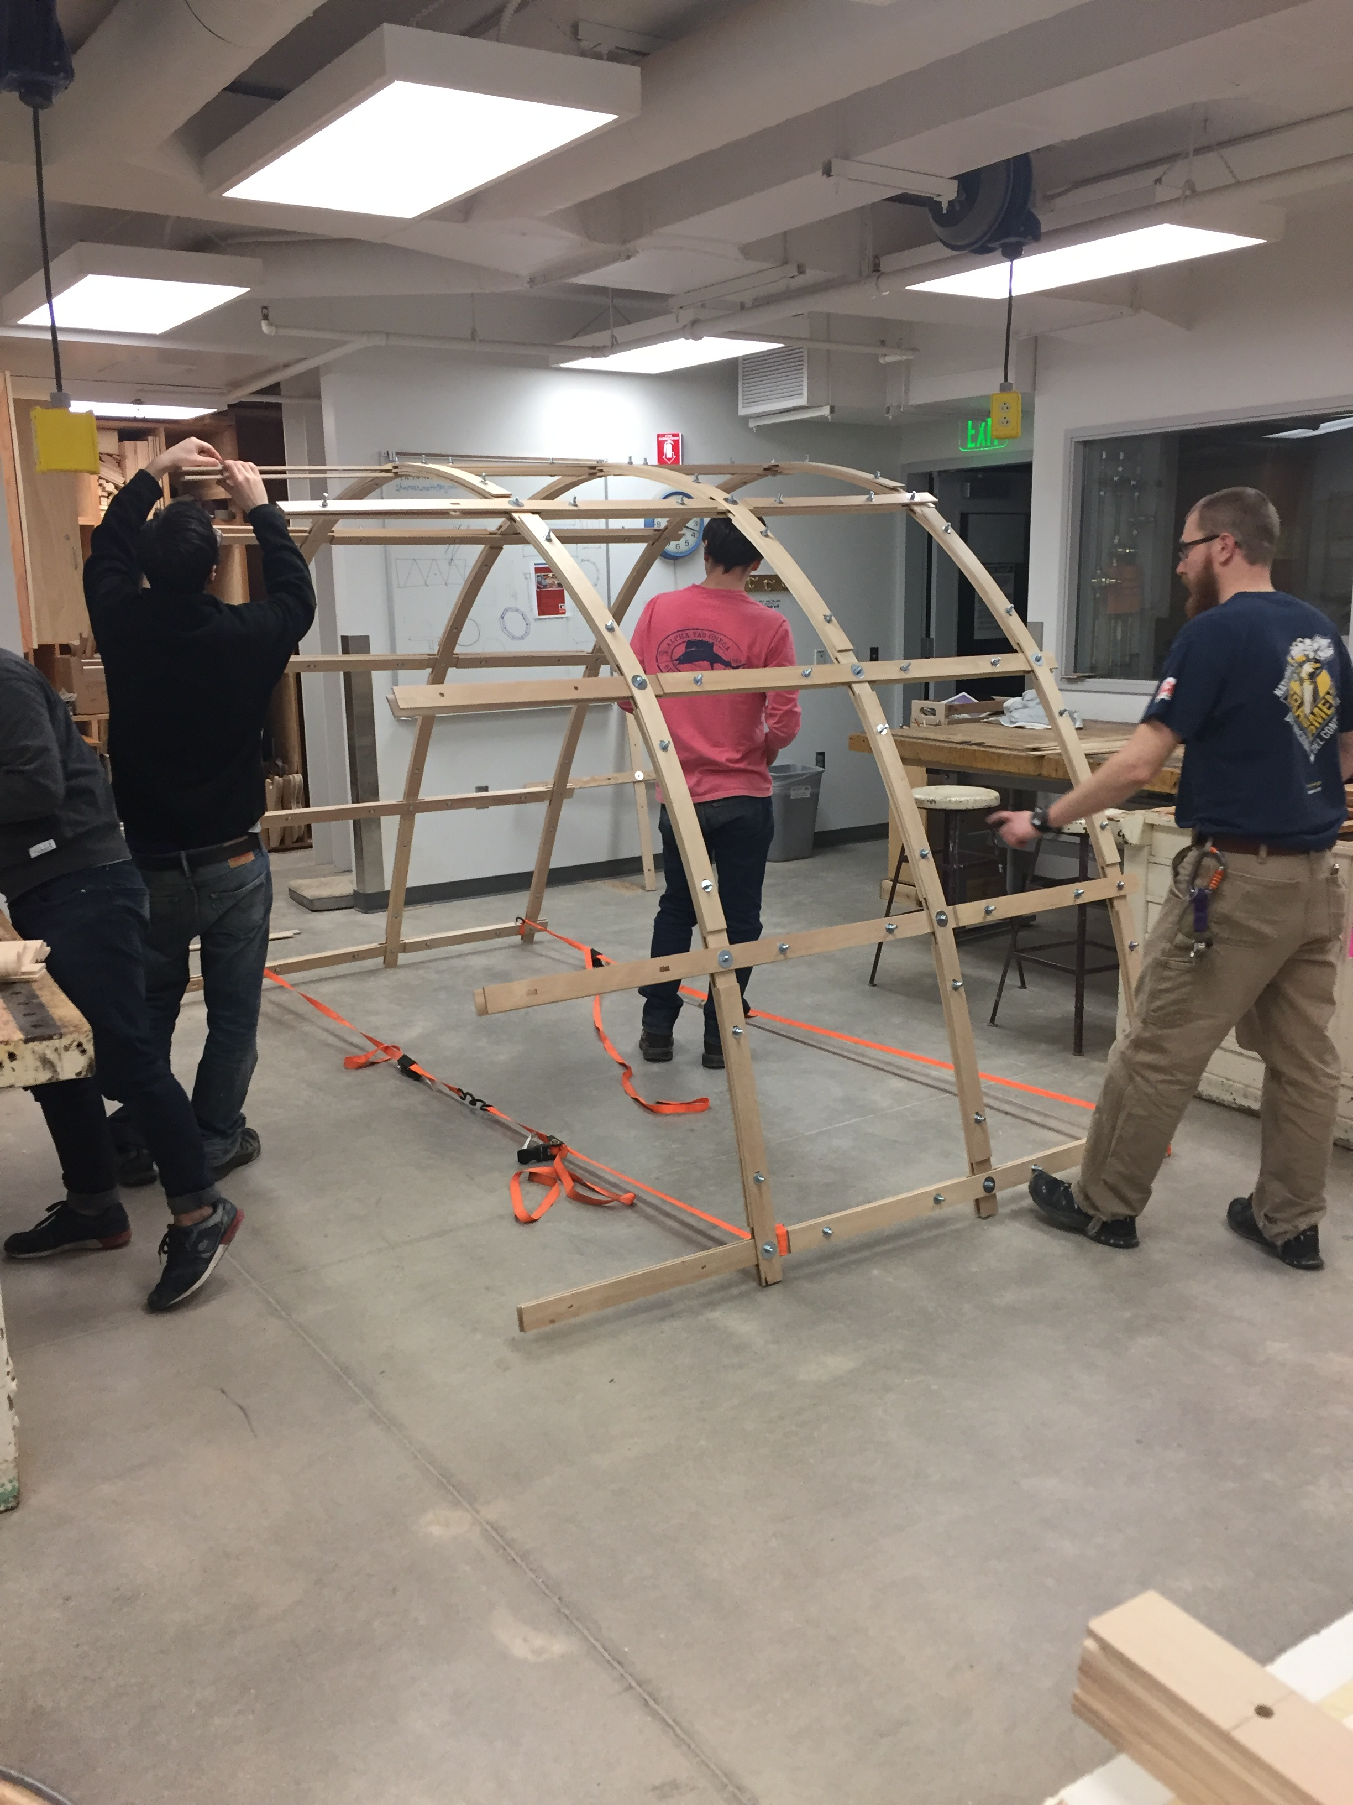
Work Process
Date: March 19 2017 Topic: Canopy Final

Slide 31
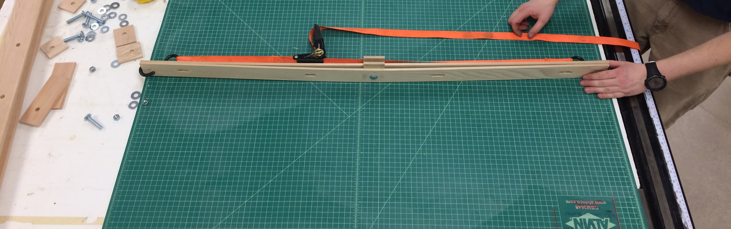
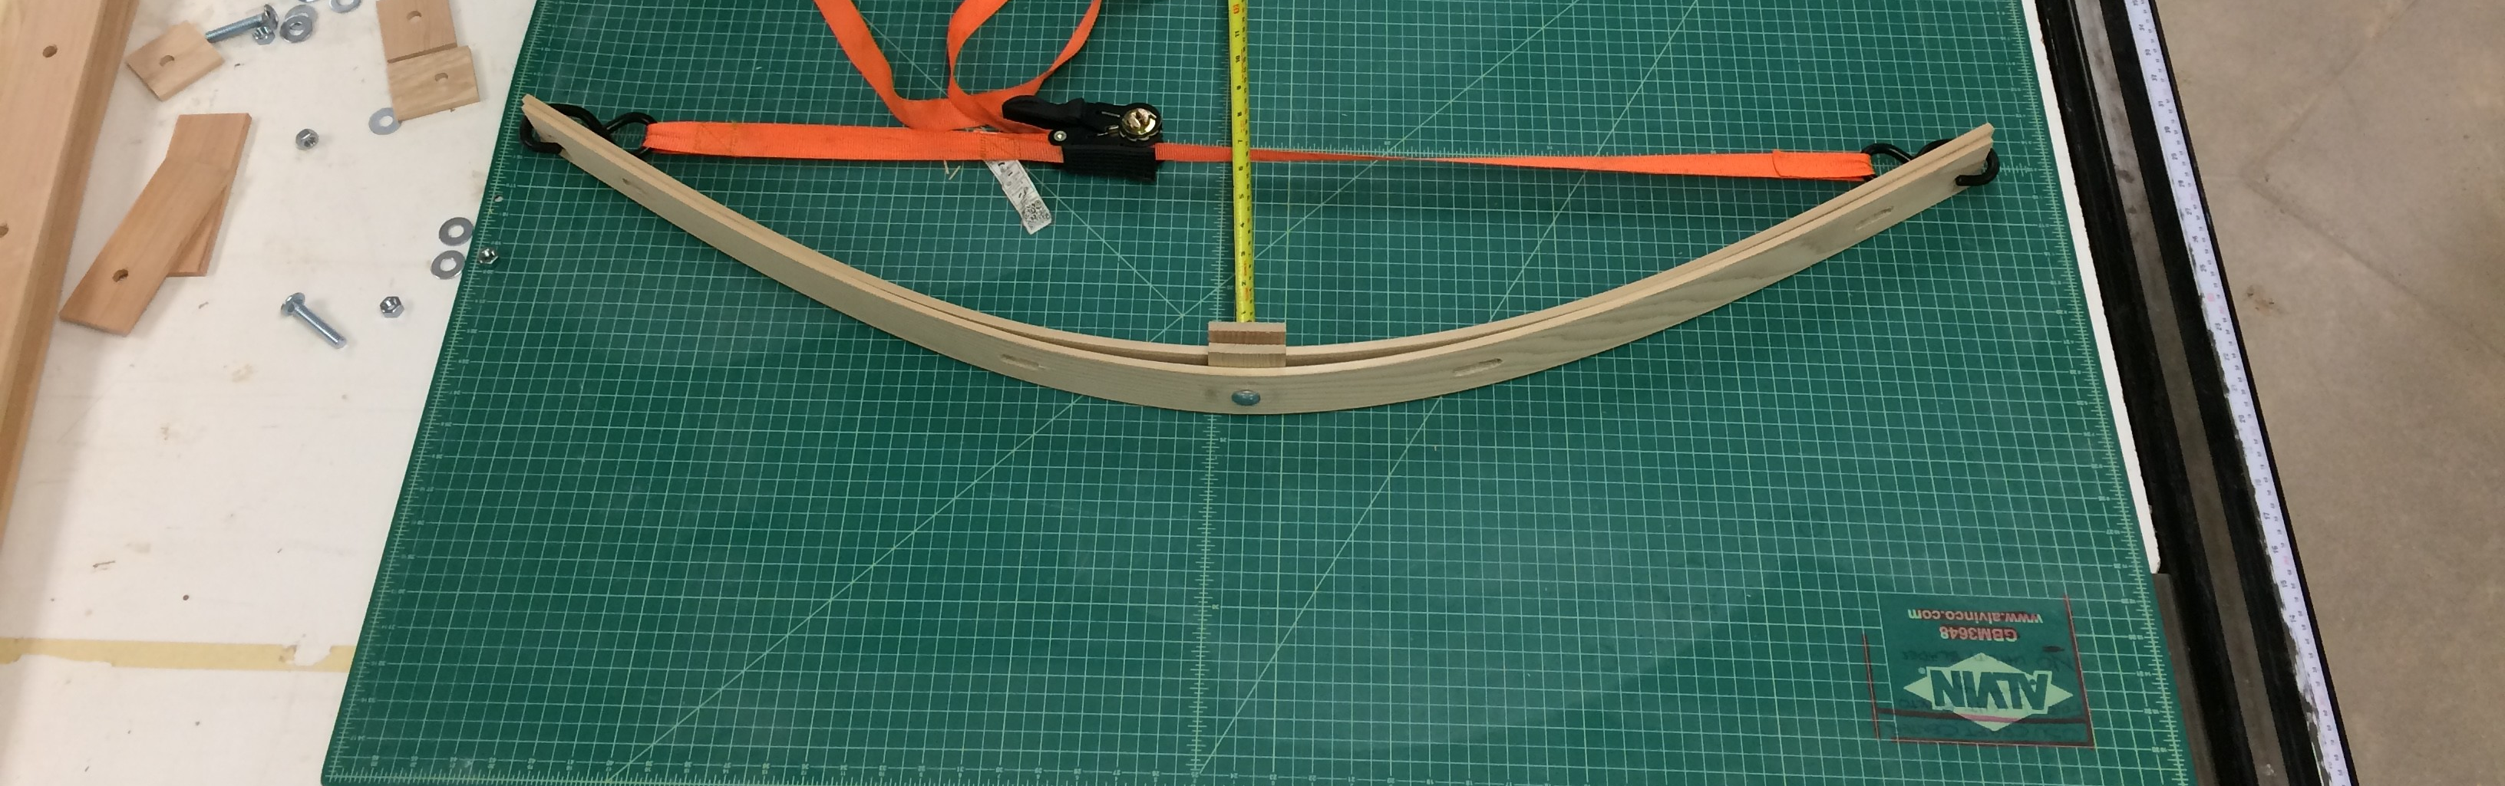
Bending Test
Date: March 19 2017 Topic: Canopy Final
Single Unit

Slide 32
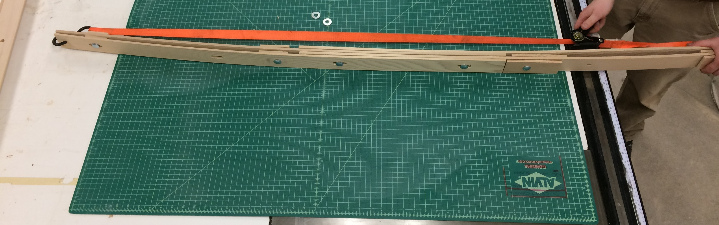
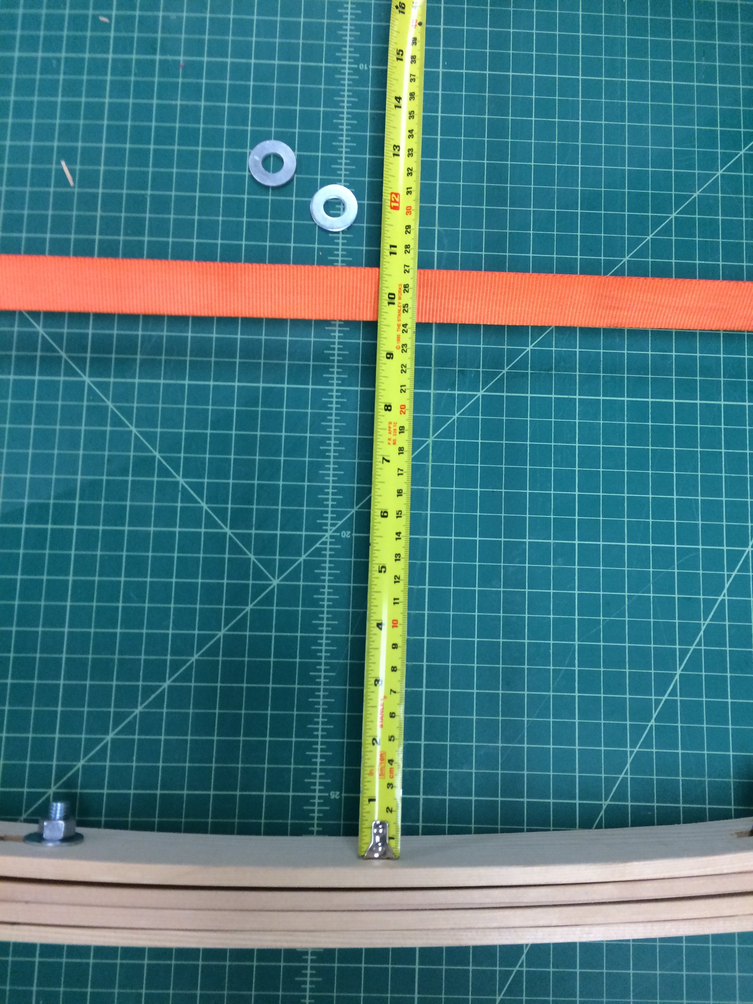
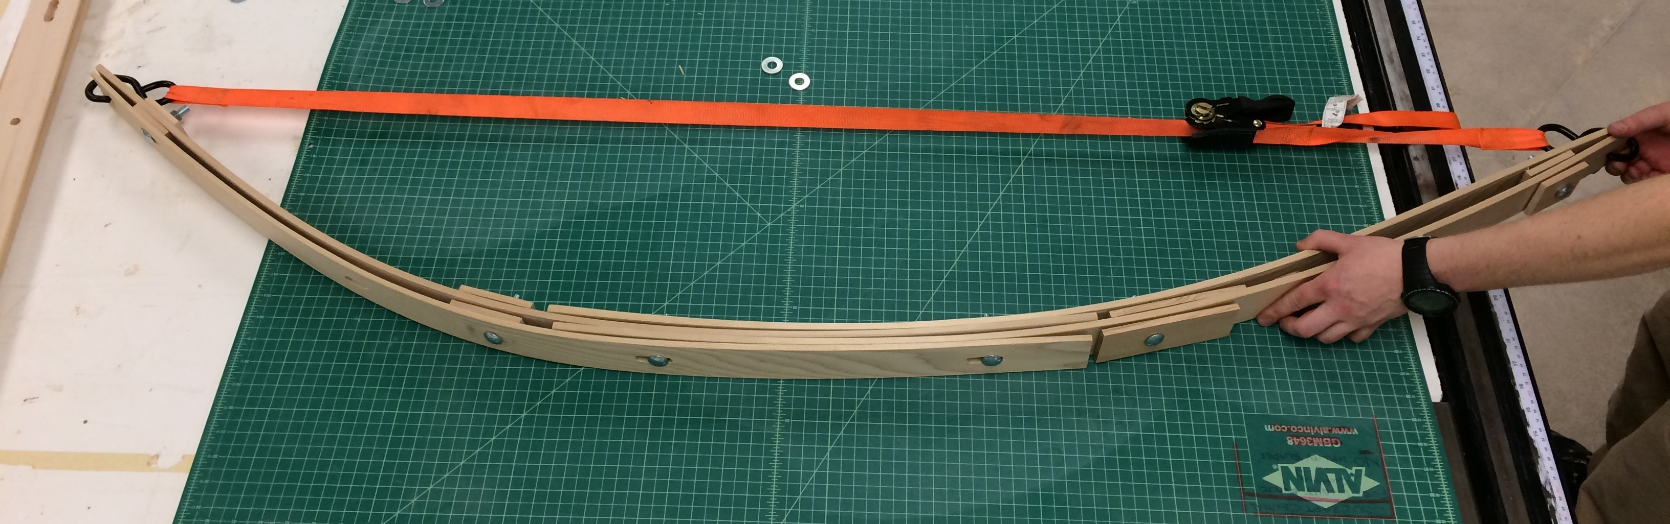
Bending Test
Date: March 19 2017 Topic: Canopy Final
Two Units
WEEK #

Slide 33
Credits
List of Teammates:
Valentina Leoni
vleoni@uoregon.edu
Josh Rosenthal
jrosent2@uoregon.edu
Jin Zhengxian
zjin@uoregon.edu
Tygh Parr
parrt@oregonstate.edu
Will Searcy
wsearcy@uoregon.edu
(REPLACE THIS WITH YOUR OWN IMAGE
OR A CITED CREATIVE COMMONS IMAGE]
GROUP WORKING PORTFOLIO
PROFESSORS MARIAPAOLA RIGGIO AND NANCY YEN-WEN CHENG WINTER 2017

